Slide 1


M ON T H DD
2022
P R E S EN TER N A M E
MAIN TITLE
SECOND LINE
SUBTITLE OR FURTHER DESCRIPTION, AS NECESSARY – CAN BE MULTIPLE LINES

Slide 2
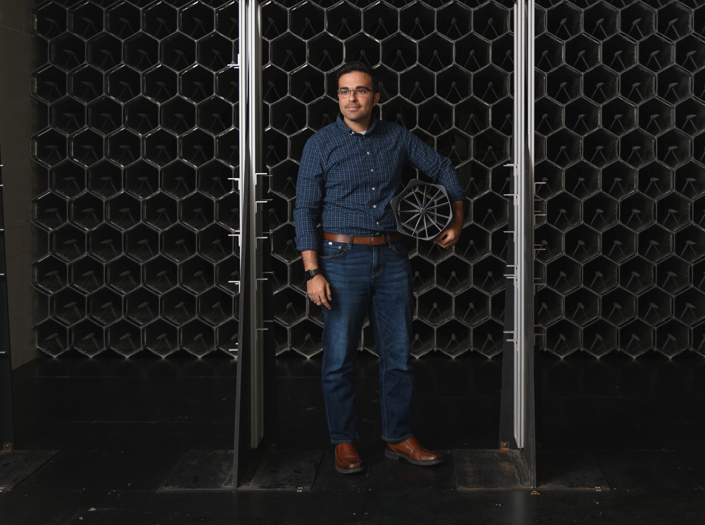
T I T L E S E T U P L I N E
M A I N T I T L E L I N E
M O N T H D D , 2022
P R E S EN T ER N A M E

Slide 3



MAIN TITLE
SECOND LINE THIRD LINE
S U B TI TL E O R F U R TH ER
D E S C R I P T I O N, A S N E C E S S A RY – C A N B E M U LT I P L E L I N E S
M O N T H D D , 2021
P R ESE N T E D BY N A M E

Slide 4

I N T R O D U C T I O N
FIRS T L AS T N A ME
Primary Title Line
SECOND TITLE LINE IF NEEDED
4

Slide 5


I N T R O D U C T I O N S
FIRS T L AS T N A ME
Title Primary Line Second Line If Needed
FIRS T L AS T N A ME
Title Primary Line Second Line If Needed
5

Slide 6



I N T R O D U C T I O N S
FIRS T
L AS T NAME
Title Primary Line Second Line If Needed
FIRS T
L AS T NAME
Title Primary Line Second Line If Needed
FIRS T
L AS T NAME
Title Primary Line Second Line If Needed
6

Slide 7

SECTION
SECTION ONE
TITLE
7

Slide 8
SECTION
SECTION ONE
TITLE
8

Slide 9
This slide is a section setup slide. Here you can use some copy to setup the topic at hand, provide some background context, or provide other helpful information.
Aborrum alibus unt intur? Ut odiores equatem rat aute sit, andae delluptat odicipis pliquidus molupta doles soluptatqui adi aut lam eat dolo exereperum alitium sed eatem velit aut est ut recab ide nus estio dus, oditatur? Et pratur rem arum atis auta delignate nobis
dolecaborum, in res doluptat est voluptate nos am facea doluptu sanditia volum, non expeditatior alit evelit.
S E C T I O N #
SECTION TITLE
Covered in this section:
Section Item | Section Item | Section Item Section Item | Section Item
D O C U M E N T T I T L E | S E C T I O N T I T L E
9

Slide 10
This slide is a section setup slide. Here you can use some copy to setup the topic at hand, provide some background context, or provide other helpful information.
Aborrum alibus unt intur? Ut odiores equatem rat aute sit, andae delluptat odicipis pliquidus molupta doles soluptatqui adi aut lam eat dolo exereperum alitium sed eatem velit aut est ut recab ide nus estio dus, oditatur? Et pratur rem arum atis auta delignate nobis
dolecaborum, in res doluptat est voluptate nos am facea doluptu sanditia volum, non expeditatior alit evelit.
S E C T I O N #
SECTION TITLE
Covered in this section:
Section Item | Section Item | Section Item Section Item | Section Item
D O C U M E N T T I T L E | S E C T I O N T I T L E
10

Slide 11
Section Header Here
SLIDE TITLE LINE TWO
Body copy can go here. Ma conse et, tem faccum faccab ium arita dolupta tiissequia erferro doluptati abores mi, atur, verferc ilitatqui atio expla nisqui re cusae pa cus expere voluptati volupta tiuntur adit
SHORT LIST TITLE HERE
Bullet point list item goes here
Bullet point list item goes here
Bullet point list item goes here
Bullet point list item goes here
Bullet point list item goes here
Bullet point list item goes here
D O C U M E N T T I T L E | S E C T I O N T I T L E
11

Slide 12
SLIDE TITLE LINE TWO
Section Header Here
Body copy can go here. Ma conse et, tem faccum faccab ium arita dolupta tiissequia erferro doluptati abores mi, atur, verferc ilitatqui atio expla nisqui re cusae pa cus expere voluptati volupta tiuntur adit Solorum expliciet exceseq uiaepudit voles voles cus. On non consed enditaeptia perit utem. Exerovit ero consers peliquas iures des restrum aciae excea non reicidi tisquis pore pratur? Quis aperum commolo.
Ri re plitatis sitis eatatia volupis enimi, con pos el il ipsanda am fugitem alitibus, unt et rectoribus, aut qui od quam fugia prora ne re etur moluptas duntissus ant volupta tquaspellab ist, cus adignat urerisi qui cus voluptatin nossi ut pos si dolupta posam quid eum unt venis minvellupti consed
mosame nonsequo qui optae et lab ius eiunt estibea temoditisqui cusant odi quibusaepror aborecta.
D O C U M E N T T I T L E | S E C T I O N T I T L E
12

Slide 13
Section Header Here
SLIDE TITLE LINE TWO
Bullet point list item goes here
Bullet point list item goes here
Bullet point list item goes here
Bullet point list item goes here
Bullet point list item goes here
Bullet point list item goes here
Bullet point list item goes here
Bullet point list item goes here
Bullet point list item goes here
Bullet point list item goes here
Bullet point list item goes here
Bullet point list item goes here
D O C U M E N T T I T L E | S E C T I O N T I T L E
13

