Slide 1
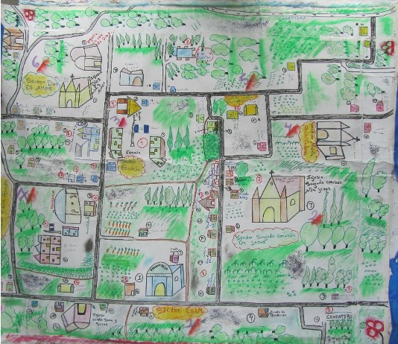
Cultural Values of Labor: An Anthropology of Economics
MURI 2020 Program Review, 26 May 2020
*
David Griffith, East Carolina University
Co-PI: MURI Migration
Project
This book, currently under review at Cambridge University Press, is based on research in Central America and Mexico that has benefited from the author’s association with the project and the project team. The book addresses how various forms of migration, particularly managed migration or guestworker programs, overlap with one another as countries attempt to meet labor market and humanitarian objectives.
MURI W911NF-18-1-0267
This work was supported by the Army Research Office/Army Research Laboratory. The views and conclusions are those of the authors and should not be interpreted as representing the official policies either expressed or implied of the Army Research Office or the US Government.
Guatemalan peasant woman’s map of her village
HRPO ARL 18-114, ARL 18-115, ARL 18-116

Slide 2
Book Outline
Introduction: Considers the origins of wage labor and how people combine wage and other forms of labor, such as reproductive and domestic productive labor.
Historical section: how labor and migration have become intertwined over time in three cases: Saami reindeer herders, Native Americans, and Palatine migrants to the New World.
Forms of Labor Chapters: Discusses how migrants in managed migration programs (between the United States and Mexico & Canada and Guatemala) influence how people combine different forms of labor at home and abroad. These often result in multiple economic livelihoods, most of which are heavily dependent on ecosystem services (farming, fishing, livestock production, etc.). Migration assists in the development and maintenance of these livelihoods and helps households in Guatemala and Mexico become more resilient to environmental changes.
Concluding Chapters: Two chapters consider, first, the growth of managed migration around the world, and, second, the theoretical implications of multiple livelihoods and migration for our understandings of economic behavior.

Slide 3
Relation between the MURI migration project and the book
Book emerged from a National Science Foundation project: Managed Migration and the Value of Labor.
However, after publishing a few articles, I began working on the MURI project, principally reviewing literature on environmental and conflict migration.
Began organizing and writing the book at the same time I was reviewing the environmental change-migration literature.
Literature review revealed a good deal of overlap: migration as a risk-reduction, livelihood diversification strategy; different kinds of migration leading to managed migration; migration building on social networks, etc.
Hence, have acknowledged the study and DoD in the book.

Slide 4
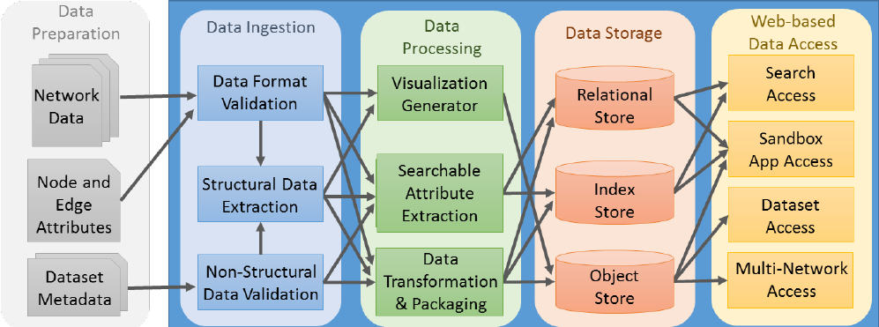
DAOME: The Data and Analytic Observatory on Migration and the Environment
*
Jeffrey C Johnson
Department of Anthropology
University of Florida
MURI W911NF-18-1-0267
HRPO ARL 18-114, ARL 18-115, ARL 18-116

Slide 5
Overview
We propose developing a comprehensive repository of migration and related environmental data and tools for analysis with a particular focus on comparative migration analysis and modeling. This repository will contain migration and refugee network data from existing sources (e.g., UNHCR) with tools to incorporate existing data into future migration research. Interest in the environmental drivers of migration is increasing mainly due to clear evidence of climate change.

Slide 6
Overview (Cont.)
In The Data and Analytic Observatory on Migration and the Environment (DAOME), we envision a migration data and tools interactive web portal, allowing data management and processing that will provide:
(a) a searchable and integrated database of migration and refugee networks, associated meta-data (e.g., on remittances, trade networks), references, and context information;
(b) access to datasets in several open formats, statistical structural information automatically extracted from the migration network structural data, and non-structural metadata;
(c) environmental datasets that can be linked temporally and spatially to relevant migration data;
and (d) access to notebooks of scripts that can show specific uses of the migration network data in the form of gists.
In addition, DAOME will provide a set of interfaces: to enable access to tools for data collection, analysis, modeling, and visualization, targeting research and education, to interact with users in the process of adding new datasets, and to support administrative operations such as managing users.

Slide 7
Scientific Significance
DAOME will move the study of environmental drivers of migration from the realm of stand-alone case study analysis to comparative cross-case exploration and modeling, furthering the development of even richer predictive theory and application of modeling tools. This migration network data observatory will advance theory in several social sciences, providing resources for statistical and mathematical modelers.

Slide 8
Overall Objective
The overarching goal of the project is to develop a modeling platform to explore different approaches at multiple spatiotemporal scales as well as strike the right balance of predictive power and facilitation of the development of an integrative theory of migration and environmental change.
The project’s multi-method approach includes social network analysis, global sensitivity analysis, Bayesian inference, mechanistic dynamical system modeling, and agent-based modeling. These methods are also modified and combined into novel methods to tackle the complex dynamics of human migration and environmental change.

Slide 9
Specific Objectives
Objective 1: create a general repository for migration and refugee network data that enables social scientists to explore general laws governing the environmental drivers of migration.
Objective 2: use automated tools for archiving and analysis and data fusion tools to move beyond a static repository.
Objective 3: make this interactive observatory akin to a single comprehensive source for migration modeling and analysis.
Objective 4: build a sustainable system. To do this we envision creating an interactive observatory – a living digital library – for migration and environmental data replete with tools for future growth and development.

Slide 10
Data Acquisition Plan
Translate existing data
Keeping Up and Providing for the Submission of New Data
Augmenting Migration Network Information
Attribute data and metadata

Slide 11
Sources of Data Compiled
Type | Description | Source/host | Stock/flow | Temporal coverage | Periodicity | Location | Level
International migration | Worldwide net migration 2012 and 2017 | World Bank Group | stock | 2012, 2017 | annual | worldwide | International
International migration | Worldwide bilateral migration 2010 | World Bank Group | stock | 2010 | single year | worldwide | International
International migration | Physician emigration | World Bank Group | stock | 1994-2004 | annual | worldwide | International
International migration | Bilateral migration by decade | World Bank Group | stock | 1960-2000 | decades | worldwide | International
International migration | Skilled worker migration | World Bank Group | stock | 1990-2010 | decades | worldwide | International
International migration | Palestinian refugees by country of asylum | World Bank Group | stock | 1990-2016 | annual | Palestine to worldwide | International
International migration | International migrant stock, % of population | World Bank Group | stock | 1990-2015 | quinquennial | worldwide | International
International migration | International migrant stock, total | World Bank Group | stock | 1965-2015 | quinquennial | worldwide | International
International migration | Refugees by country of origin | World Bank Group | stock | 1990-2016 | annual | worldwide | International
Internal displacement | Yemen, internally displaced people | Humanitarian Response | stock | 2015-2017 | single count | Yemen | Internal
International migration | Refugees, asylum seekers, returnees | Humanitarian Data Exchange | ? | 2002-2013 | annual | worldwide | International
International migration | Children: refugees, asylum seekers, IDP | Humanitarian Data Exchange | stock | 2015 | single count | worldwide | International, internal
International migration | Venezuelan migration, destination Americas Spain | Humanitarian Data Exchange | stock | 2017 | single count | Venezuela to Americas/Spain | International
International migration | Migration flows to Europe from south | Humanitarian Data Exchange |  | 2015-2017 | yearly | worldwide to Europe | International
Remittance data | Presentation on remittances in West Africa |  |  |  |  | Africa | Regional
Remittance data | remittance flow
Remittance data | remittance flow
Remittance data | remittance flow
Remittance data | remittance flow
Remittance data | remittance flow
Remittance data | remittance flow
Remittance data | remittance flow
Remittance data | remittance flow
Remittance data | remittance flow
Remittance data | remittance flow
Remittance data | remittance flow

Slide 12
Migration policies
Replication Files | replication for work to predict IDP flows in Syria and Yemen
Replication Files | replication for analysis on IDPs in Nepal
Replication Files | replication for Justin's papers using Somalia IDP flow data
Replication Files | replication for 2015 article in Political Geography
Replication Files | replication for work on political cleansing in Colombia
Replication Files | replication for paper on how migration in feudal Japan lowered tax rates
Migration survey | lots of World Bank surveys
Migration survey | Justin's survey instrument from interviews with Syrians in Turkey
Migration survey | cool work on several African nationalities
CCAPS | infrastructure data from CCAPS project
CCAPS | geocoded data on climate aid projects in Malawi
CCAPS | data on World Bank climate aid projects
Arms flows | SIPRI arms transfers database annually 1950-2017
strategic rivalries | strategic rivalries 1816-2010 |  |  | 1816-2010
Travel from Puerto Rico | flights to San Juan, monthly |  | flow
Travel to Puerto Rico | flights from San Juan, monthly |  | flow
Arms flows | deals for international arms transfers |  |  | 1950-1970
Arms flows | deals for international arms transfers |  |  | 1971-1980
Arms flows | deals for international arms transfers |  |  | 1981-1990
Arms flows | deals for international arms transfers |  |  | 1991-2000
Arms flows | deals for international arms transfers |  |  | 2001-2017
Ethnic Refugee populations |  |  |  | 1975-2016
Internal displacement | IDPs in Somalia & some international returnees | Humanitarian Data Exchange |  | Pre-2015, 2015, 2016 | 3 time periods | Somalia | Internal
Internal displacement | Somalia drought displacement tracking | Humanitarian Data Exchange |  | 2016-2017 | continuously updated | Somalia | Internal
International migration | Nationalities migrants arriving to Italy & Greece | Humanitarian Data Exchange |  | 2015 | single count | worldwide to Italy & Greece | International
International migration | Migrants in Venezuela by country of birth | Humanitarian Data Exchange |  | 2011 | single count | worldwide to Venezuela | International
International migration | Resettlement arrivals of refugees in Canada | Humanitarian Data Exchange |  | 1959-2017 | yearly | worldwide to Canada | International
International migration | Resettlements from Central African Republic | Humanitarian Data Exchange |  | 1990-2017 | yearly | Central African Rep. to worldwide | International
International migration | Asylum seekers in Zimbabwe from Africa & southern Europe | Humanitarian Data Exchange |  | 2000-2017 | yearly | Zimbabwe from regional | Regional
International migration | Refugees in Yemen | Humanitarian Data Exchange |  | 2000-2017 | yearly | Worldwide to Yemen | International
Migrant deaths | Records and causes of migrant deaths worldwide | Humanitarian Data Exchange |  | 2017 | single count | Worldwide | International
International migration | Africa total migrants by country | Humanitarian Data Exchange |  | 2006-2015 | yearly | Africa | International
International migration | Migrant arrivals in the Balkans | Humanitarian Data Exchange | flow | 10/1/2015-9/21/2016 | daily | Balkans | International
Migrant deaths | Refugees & migrant deaths en route to Europe | Humanitarian Data Exchange |  | 01/2000-6/2016 | monthly | in & on way to Europe | International
International migration | Uzbek migrants worldwide | Humanitarian Data Exchange |  | 1992-2017 | yearly | worldwide | International
International migration | Asylum seekers in Vanuatu | Humanitarian Data Exchange |  | 2007-2016 | yearly | worldwide to Vanuatu | International
International migration | Asylum seekers in Uzbekistan | Humanitarian Data Exchange |  | 2000-2007 | yearly | worldwide to Uzbekistan | International
International migration | Uruguayan migrants worldwide | Humanitarian Data Exchange |  | 1976-2014 (irregular) | yearly | Uruguay to worldwide | International
International migration | Asylum seekers in Uruguay | Humanitarian Data Exchange |  | 2000-2017 | yearly | worldwide to Uruguay | International
International migration | Asylum seekers in Tanzania | Humanitarian Data Exchange |  | 2000-2017 | yearly | worldwide to Tanzania | International
International migration | Asylum seekers in United Kingdom | Humanitarian Data Exchange |  | 2000-2017 | yearly | worldwide to USA | International
International migration | Asylum seekers in United States | Humanitarian Data Exchange |  | 2000-2017 | yearly | worldwide to UK | International
International migration | Asylum seekers in United Arab Emirates | Humanitarian Data Exchange |  | 2000-2017 | yearly | worldwide to UAE | International
International migration | Ukranian refugees worldwide | Humanitarian Data Exchange |  | 1992-2017 | yearly | Ukraine to worldwide | International
International migration | Asylum seekers in Ukraine | Humanitarian Data Exchange |  | 2000-2017 | yearly | worldwide to Ukraine | International
Internal migration | Puerto Rico fatality and displacement data from Harvard research team | .
International migration | international migration data
International alliances | alliances between countries 1815-2016 |  |  | 1815-2016 |  |  | international
 | UNHCR refugee and IDP camps (not all, just some of them) | .
 | Syria IDP camp locations April 2015
 | Syria IDP camp locations June 2015

Slide 13
International migration | Ugandan refugees worldwide | Humanitarian Data Exchange |  | 1972-2017 | yearly | Uganda to worldwide | International
International migration | Asylum seekers in Uganda | Humanitarian Data Exchange |  | 2000-2017 | yearly | worldwide to Uganda | International
International migration | Asylum seekers in the Turks and Caicos | Humanitarian Data Exchange |  | 2011-2017 | yearly | worldwide to Turks and Caicos | International
International migration | Turkmen refugees worldwide | Humanitarian Data Exchange |  | 1994-2015 | yearly | Turkmenistan to worldwide | International
International migration | Asylum seekers in Turkmenistan | Humanitarian Data Exchange |  | 2000-2011 | yearly | Worldwide to Turkmenistan | International
International migration | Turkish refugees workdwide | Humanitarian Data Exchange |  | 1959-2017 (irregular) | yearly | Turkey to worldwide | International
International migration | Asylum seekers in Turkey | Humanitarian Data Exchange |  | 2000-2017 | yearly | worldwide to Turkey | International
International migration | Tunesian refugees worldwide | Humanitarian Data Exchange |  | 1990-2017 | yearly | Tunesia to worldwide | International
International migration | Asylum seekers in Tunesia | Humanitarian Data Exchange |  | 2000-2017 | yearly | worldwide to Tunesia | International
International migration | Asylum seekers in Trinidad and Tobago | Humanitarian Data Exchange |  | 2007-2017 | yearly | worldwide to Trinidad and Tobago | International
International migration | Tongan refugees worldwide | Humanitarian Data Exchange |  | 2009, 2016 | two counts | Tonga to worldwide | International
International migration | Asylum seekers in Tonga | Humanitarian Data Exchange |  | 2010-2012 | yearly | worldwide to Tonga | International
International migration | Togolese refugees worldwide | Humanitarian Data Exchange |  | 1990-2017 | yearly | Togo to worldwide | International
Infrastructure | Geo-located global power plants | World Resources Institute |  |  |  | global
Public opinion | multi-round survey of Germans with many questions on attitudes towards immigrants |  |  |  |  |  | country
Internal migration | internal migration within USA based on IRS | IRS |  | 1990-2011 | yearly | USA | state; county
Internal and International migration | Latin American Migration Project surveys | LAMP
 | Syrian refugee populations by country and total for the Middle East | UNHCR | stocks | 2011- September 2017 | varies; sometimes every day, sometimes every couple weeks | Middle East
 | refugee and IDP sites | UNHCR
Puerto Rico population | ACS Puerto Rico 2005-2017 population data | ACS | stocks | 2005-2017 | yearly | Puerto Rico | US territory
 | East Puerto Rico damage map | NASA |  | 2017 |  | Puerto Rico
 | West Puerto Rico damage map | NASA |  | 2017 |  | Puerto Rico
 | Syrian asylum applications by country in Europe | Eurostat |  | 2017-2018 | monthly | Europe
 | Syrian asylum applications by country in Europe | Eurostat |  | 2008-2017 | yearly | Europe
Internal migration | New displacement by disaster event | IDMC |  | 2008-2017 | 4816 events | global
Displacement | Disaster related deaths and displacement | EMDAT &IDMC |  | 2008-2017 | events | global | worldwide
Detention centers | List of global detention centers, population | Global Detention Project |  | Status 2018 |  | global | worldwide
Geographic distance | Distances between administrative region centroids |  |  |  |  | Somalia | internal
US migration as of July 1: 2017-2018 | state-level migration and migration from Puerto Rico | US Census Bureau |  | 2017-2018 | year | United States | internal
trade | international trade | Correlates of War |  |  | year | global
refugee stocks | dyadic refugee populations; We have a lot of files in this folder that converted the data into various forms. | UNHCR |  | 1976-2016 | year | global
country indicators | country-level variables like regime type and GDP all merged with COW codes | Graham data repository |  |  | year | global

Slide 14
Data Standardization Efforts
Description
At country level, standardize which countries are included and merge based on COW codes to minimize errors.
Sub-nationally, we attempt to merge based on pcodes whenever possible. Shapefiles often include pcodes, which helps. When pcodes are not available, we have to make sure that all place names are spelled the same. This is a big issue for Somalia, for example.
Our team is spread across Google Earth Engine, Stata, R, Matlab, ArcGIS, UCINET, Excel, and Grass, among other programs.
We convert country-level data to gradient matrices.
We convert dyad-level data from edgelists to matrices.
Sometimes, we convert undirected dyads to directed dyads to use as a skeleton for additional merging.
We convert dyads to network files
We figured out how to create dynamic networks.
We attempted to merge data on natural disasters and disaster-induced displacement from EM-DAT and IDMC. This process failed unfortunately because there is not currently a unique identifier to merge them. We reached out to IDMC to ask about the status of a proposed GLIDE indicator, but that is still in progress.

Slide 15
Data Programming Efforts
File | Purpose
AutomatedSyriaHTMLDataDown…Aug2018.R | Scrape the Violations Documentation Centre website for Syrian fatality data 2011-present
DataPrepFor_NetworAnalysis_EG5Nov18.R | Prepare UNHCR refugee flow data for network visualization and analysis
Geissler EMDAT$IDMC_DateMerge.R | Attempt to merge EM-DAT natural disaster data and IDMC disaster displacement data. Mostly, this fails, but we learned a lot from it.
Alison file for soil moisture | Prepares Somalia province-level soil moisture data
Alison file for temperature | Prepares Somalia province-level temperature data
Alison file for precipitation | Prepares Somalia province-level precipitation data
Creating directed dyad data.R | Created directed dyad skeleton
Dynamic_NetworkVisualization_Elise_23Jan2019.R | Creates dynamic network visualization
Syria_IDP flow network.R | Does a lot with Syrian IDP flow, violence, and territorial control data. There are visualizations, weighted network measures, file merging, mapping, and other actions performed here.
20190502_Creating territorial control variable.R | Converted from wide data format to long data format to ease merging of territorial control variables into a panel data file
Analysis_A+J.do | Stata do file that does panel event count regressions, plotting, and panel vector autoregressions for analysis of Syrian IDP flows and violence
Syria_Dynamic Network.R | Creates GIFs of Syrian IDP flows
ADM4_Syria_models.R | Does community level analysis of IDP flows, territorial control, and violence in Syria
creating province variables.do | Work product that helped create and clean variables in Stata
Modelling with pvar.do | Early modelling with panel vector autoregressions for Syrian IDP flow and violence analysis
Carrying capacity exploratory analysis.do | Nonparametric regressions of refugee flows and violence against and by refugees
Matrix creation_MRQAP.R | Creates square matrices and performs MR-QAPs with statnet in R (we have also tried the asnipe R package)
Ego network analysis_MRQAP.R | Early ego network analysis
Elise R file to create ego networks | Creates ego refugee flow networks for Syria and Somalia
ACLED & UCDP region variables.R | Creates region-level violence variables for Somalia
Matrix prep script.R | Creates matrices of IDP flows by self-reported primary reason of displacement in Somalia
Ayse prep work in R | Preparing matrices and analysis
Ayse work in Matlab | Modelling
Michael and Alison on Google Earth Engine | Create environmental variables
MURI_review_year1.R | Created several network plots of Somali internal displacement

Slide 16
Technological Infrastructure Development
To increase the quality, accessibility, comparability and pedagogical simplicity of human-centered relational data, the DAOME project will develop a cyberinfrastructure based on open-source production-quality software, extending and customizing it to meet the objectives

Slide 17
DAOME Web Presence
We envision the development of a data and tools web portal, i.e. a website allowing data management and processing that will provide
(a) a searchable and integrated database migration data, associated metadata, references, and context information
(b) access to datasets in a selected number of open formats, statistical structural information automatically extracted from the network structural and non-structural metadata
(c) access to notebooks of scripts that can show specific uses of the migration network data in the form of gists.

Slide 18
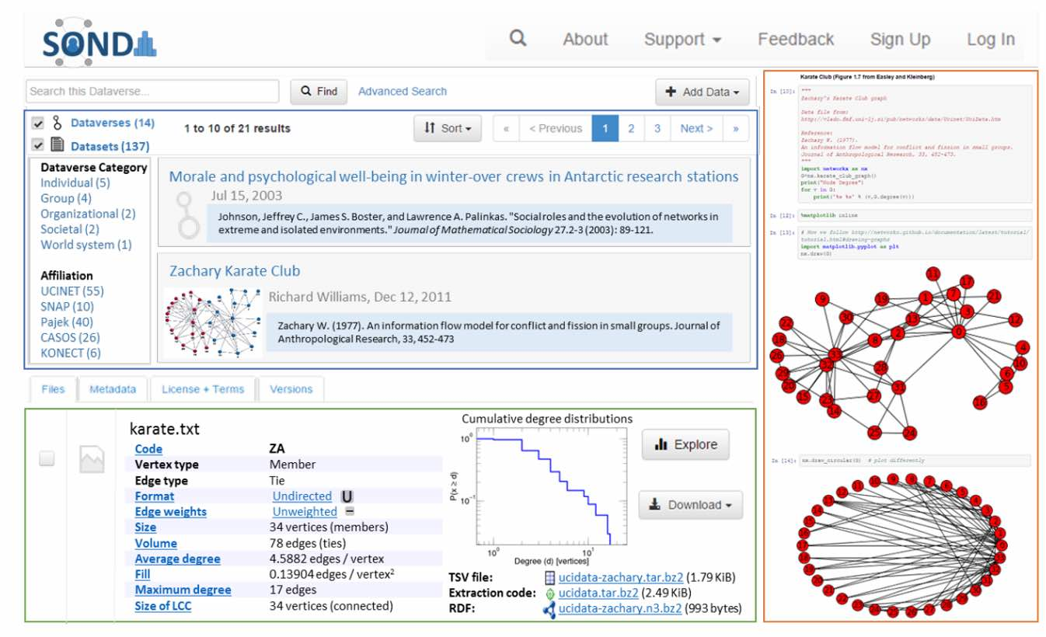
Example of similar work. Key novel features include: archive of social network datasets that is searchable (upper left box), access to datasets in a selected set of formats and display of enriched structural information automatically extracted from the dataset as well as nonstructural metadata (lower left box), and sharing of notebooks making use of the dataset as gists (right box).

Slide 19
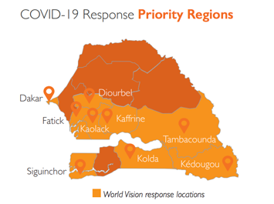
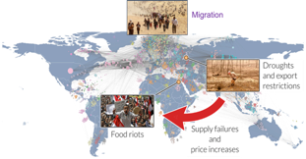
potential synergies For MURI MIGRATION NSF Convergence and DARPA World Modelers
*
Michael Puma
Columbia University
Tambacounda,
Senegal:
Complex migration story
Source: Modified from Otto et al. (PIK)
MURI W911NF-18-1-0267
HRPO ARL 18-114, ARL 18-115, ARL 18-116

Slide 20
Cross-project synergies
Intellectual and theoretical opportunities
Application opportunities

Slide 21
Cross-project synergies
Intellectual and theoretical opportunities
Application opportunities

Slide 22
NSF Growing Convergence Research
Disentangling climate, food security and social factors as drivers of migration
Focus on migration in and out of West Africa

Slide 23
What is convergence research?
“Research driven by a specific and compelling problem. Convergence Research is generally inspired by the need to address a specific challenge or opportunity, whether it arises from deep scientific questions or pressing societal needs”
“Deep integration across disciplines. As experts from different disciplines pursue common research challenges, their knowledge, theories, methods, data, research communities and languages become increasingly intermingled or integrated. New frameworks, paradigms or even disciplines can form sustained interactions across multiple communities.”
Source: https://www.nsf.gov/od/oia/convergence/index.jsp

Slide 24
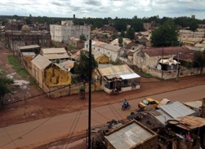
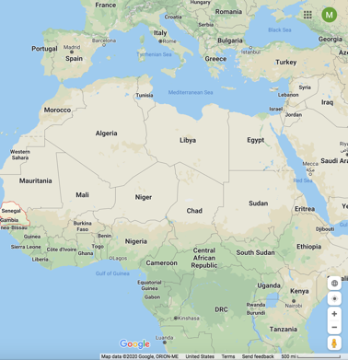
Tambacounda Region of Senegal
Tambacounda
Region
Image: Pape Faye, 2/14/2020 presentation
Why do farmers migrate?
Weather generally not mentioned
Subsistence crisis
Few gov. services
Emigrants/remittances
Coming of age issue
Precarity => constant anxiety
Disenfranchised with local/national gov.
Source: https://reliefweb.int/sites/reliefweb.int/files/resources/Senegal_Sit%20Rep%201_final.pdf
Based on discussions with Jesse Ribot, American University

Slide 25
Tambacounda Region of Senegal
Why do farmers migrate?
Weather generally not mentioned
Subsistence crisis
Few gov. services
Emigrants/remittances
Coming of age issue
Precarity => constant anxiety
Disenfranchised with local/national gov.
Based on discussions with Jesse Ribot, American University (Advisory team)

Slide 26
Cross-project synergies
Intellectual and theoretical opportunities
Application opportunities

Slide 27
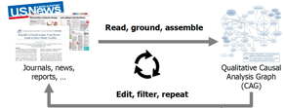
What is the goal of DARPA World Modelers?
+
Develop a suite of technologies to improve & accelerate analyses of complex systems
Domain models
AI approaches
:Source Modified from J Elliott, DARPA, Presentation, Modeling the World Workshop, 07/18/2018, Slide #3-4

Slide 28
DARPA World Modelers – Domain models
SuperMaaS, Models as a Service (Galios, Inc)
Opportunity to link in our new MURI migration theories into the SuperMaaS system
Analysts:
Policy & Academic
API for Analyst
SuperMaaS
Consists of Data Cubes
Domain Modeler
API for Domain Modeler
Put models into a ”container”
Wider dissemination possiible through World Food Program and FAO (Food security cluster, https://fscluster.org) – discussions ongoing
API for General Modeler
General Modeler

Slide 29
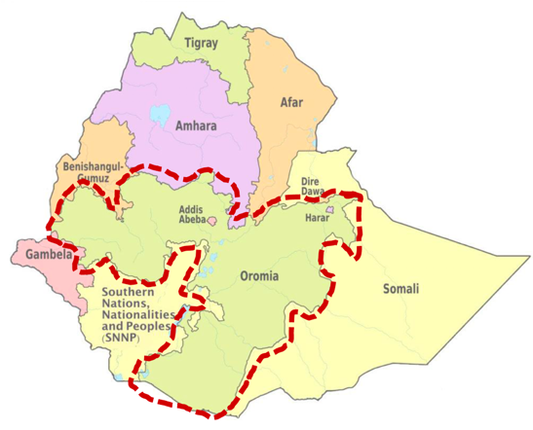
DARPA World Modelers – Ethiopia Use Case
Decision Support Modeling Tools – Ethiopia Program (DSMT-E)
2.5-year project funded by the Bill and Melinda Gates Foundation (BMGF) in partnership with DARPA’s World Modelers (WM) Program, Luma Consulting, & Addis Ababa University’s Institute of Technology (AAiT)
Goals
DSMT-E: scale analysis to whole country
WM: create the middleware for modeling and analysis; adapt the technology to other countries and contexts
18 different Ethiopia partners
Image: https://en.wikipedia.org/wiki/
Dollo_Zone#/media/File:Map_of_zones_of_Ethiopia.svg; LUMA slide, Jan 2020.

Slide 30
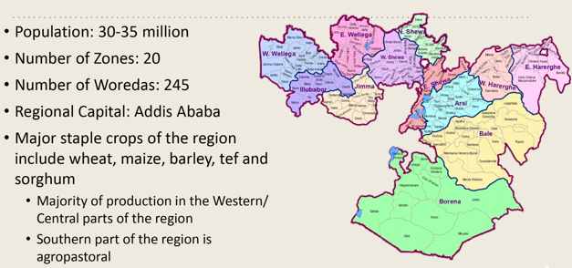
DARPA World Modelers – Food security pillars
Food Availability: Project cereal crop production in Oromia for the 2018 Belg and Meher seasons (LPJmL, APSIMx, CASES, G-Range)
Food Access: Project cereal crop prices for major markets in the region during the Meher and Belg hunger seasons (TWIST, FSC models)
Food Utilization: Project under-5 malnutrition rates in the region (CLEM)
Stability: Project the likelihood of drought/flood shocks (TWIST, FSC models)
Above from LUMA presentation: DSMT-E January 2020 Seattle Experiment, Experiment Context and Storyboard, January 13th 2019 by Luma, DARPA WM, BMGF, & AAiT
Blue text => Models in the DARPA WM system from Potsdam Institute for Climate Impact Research, CSIRO, and Columbia University

Slide 31
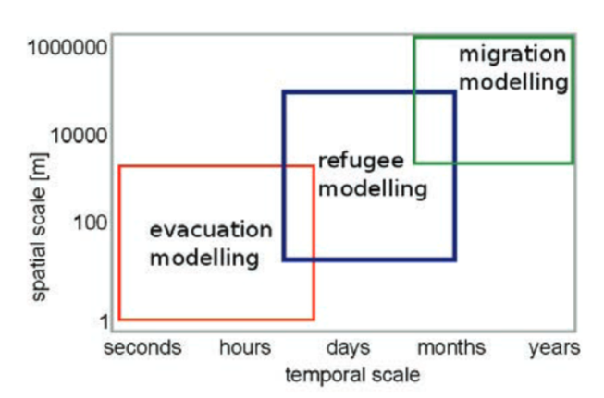
DARPA World Modelers – Human mobility
Source: Derek Groen, 2016. Simulating Refugee Movements: where would you go?

Slide 32
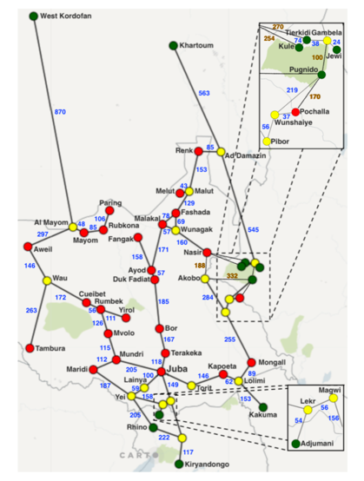
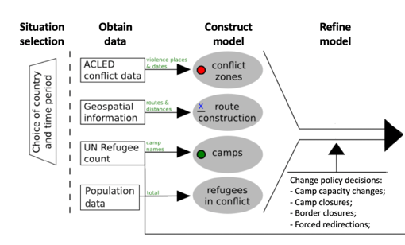
DARPA World Modelers – Refugee movement
Sudan
Flee Agent Based Model (ABM)
Simulates refugee (agent) movement from conflict zones, zones of food insecurity and flood zones (in development) to refugee camps
A long enough simulation allows all agents to be distributed to refugee camps
Code is stochastic, thus different simulations with identical inputs result in slightly different outputs
Ethiopia
South Sudan
Source: Suleimenova and Groen (2020)
Uganda
Kenya

Slide 33
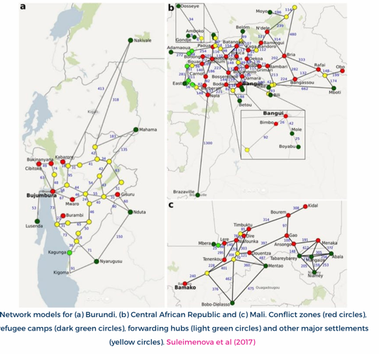
DARPA World Modelers – Refugee movement
Central African Republic
South Sudan
Mali
Central African Republic
Burundi
Somalia/Ethiopia (Keren Mezuman)
Burundi
Mali
Source: https://www.brunel.ac.uk/news-and-events/news/articles/Climate-refugees-why-we-cant-yet-predict-where-millions-of-displaced-people-will-go, accessed 4/14/2020/

Slide 34
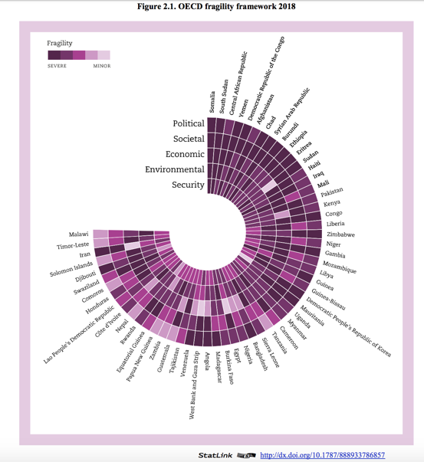
DARPA World Modelers – Up next
Fragility in East Africa
Apply WM tools
Source: OECD (2018), States of Fragility 2018, OECD Publishing, Paris, https://doi.org/10.1787/9789264302075-en.

Slide 35
Towards a multi-scale theory on coupled human mobility and environmental change
*
SUMMARY & OUTLOOK
10
1
Book forthcoming
1
Book
under review
Articles published/accepted
10
1
Website set up
1
Interdisciplinary session convened
Manuscripts submitted/under review
7+
Manuscripts under preparation
1
Comprehensive database
MURI W911NF-18-1-0267
HRPO ARL 18-114, ARL 18-115, ARL 18-116

Slide 36
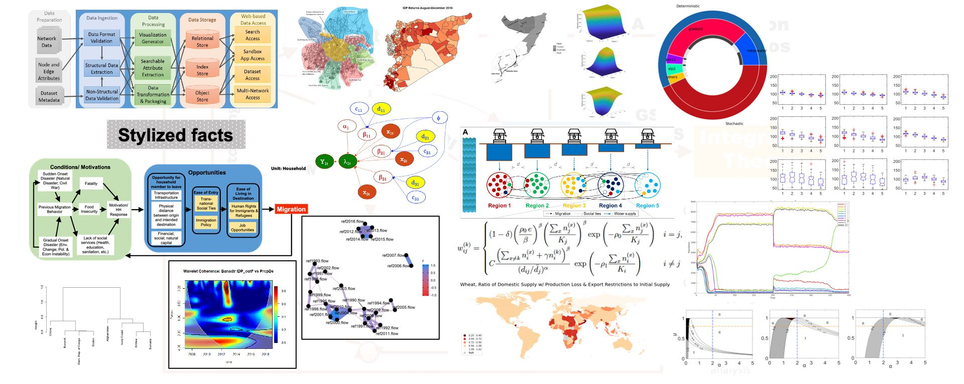
Pieces of the puzzle have been systematically tackled and connected. Further integration is next.

Slide 37
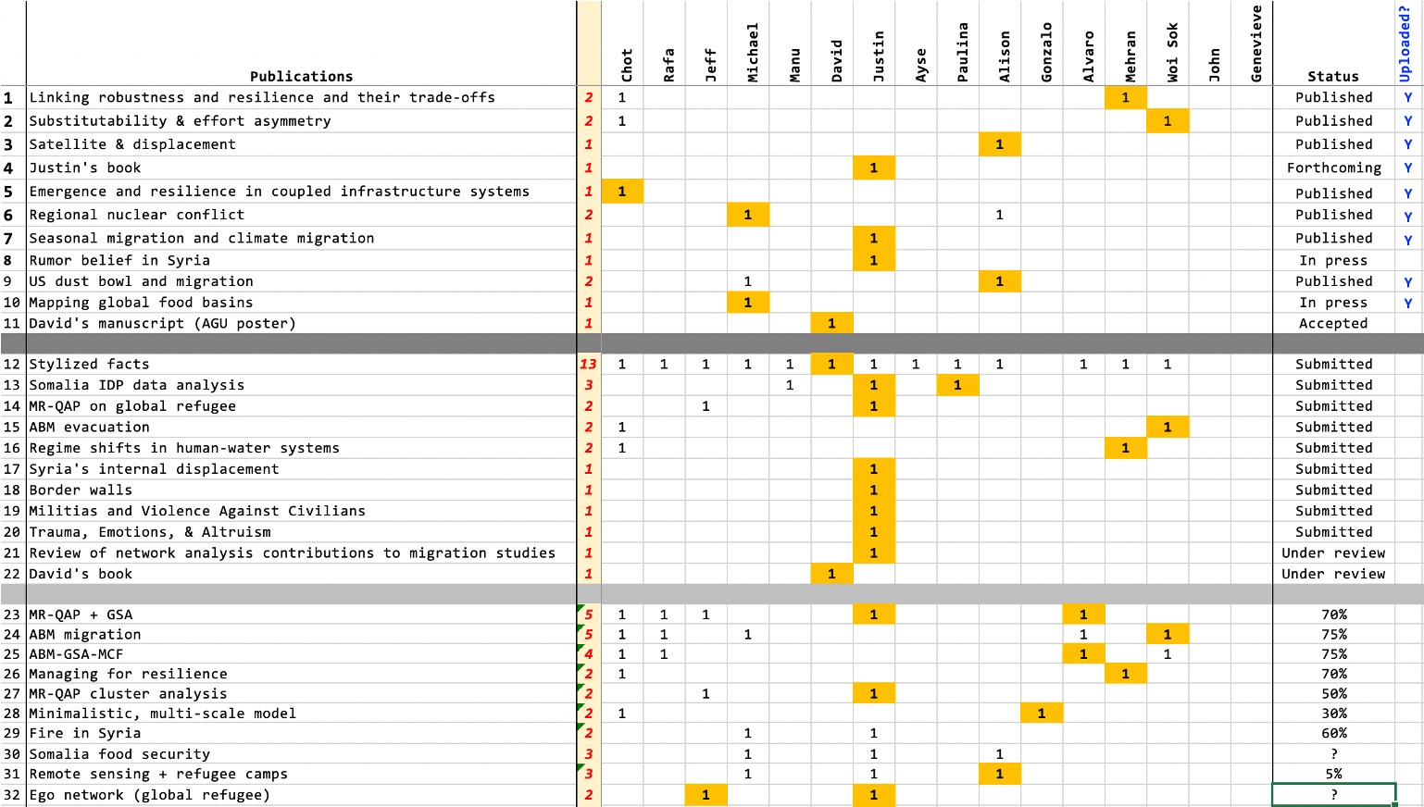
Outlook: what’s in the pipeline?

Slide 38
Outlook: what’s in the pipeline?
Continue work on ABM/GSA, MRQAP/GSA
Incorporating more environmental variables in the network analysis
Stylized facts and network analyses to inform ABMs
Connecting large-scale stressors and mechanistic models with transient behaviors of migrants
Applying Bayesian inference to these mechanistic models
More case studies
G1
Empirical
patterns
G2
Novel data analysis
G3
Mechanistic models
G4
Patterns + model

Slide 39
Outlook: what’s in the pipeline?
Workshops and sessions at conferences
Continue to disseminate and engage in potential transition pathways, e.g.,
NASA-SERVIR
NFRF (New Frontiers in Research Fund, CA)
DAOME
NSF
DARPA
G1
Empirical
patterns
G2
Novel data analysis
G3
Mechanistic models
G5
G4
Disseminate
Patterns + model

Slide 40
Pieces of the puzzle have been systematically tackled and connected. Further integration is next.
Thank you for your attention

