Slide 1

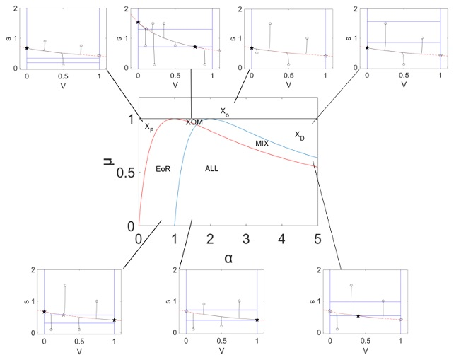
On coupled dynamics and regime shifts in coupled human-water systems
MURI 2020 Program Review, 26 May 2020
*
Mehran HOMAYOUNFAR (homayounfar@ufl.edu)
Rachata MUNEEPEERAKUL (rmuneepe@ufl.edu)
University of Florida
Agricultural & Biological Eng.
Gainesville, FL, USA
We developed a stylized model that combines hydrological and social dynamics of a generic coupled human-water system (CHWS). In this model, The population self-organizes to respond to relative benefits they derive from the water system and outside opportunities. Despite its simplicity, the model yields different regimes, governed by hydrological and socioeconomic factors.
MURI W911NF-18-1-0267
This work was supported by the Army Research Office/Army Research Laboratory. The views and conclusions are those of the authors and should not be interpreted as representing the official policies either expressed or implied of the Army Research Office or the US Government.
HRPO ARL 18-114, ARL 18-115, ARL 18-116

Slide 2
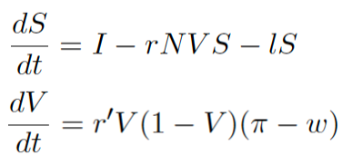
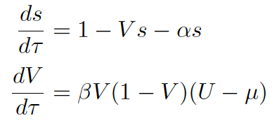
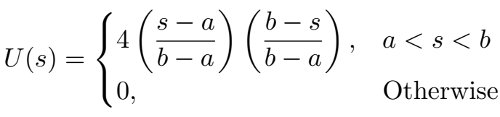
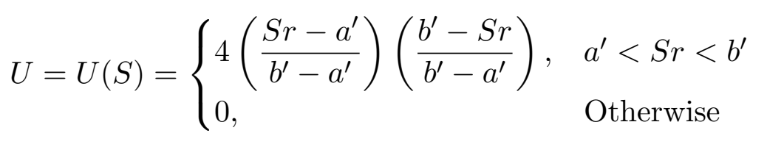
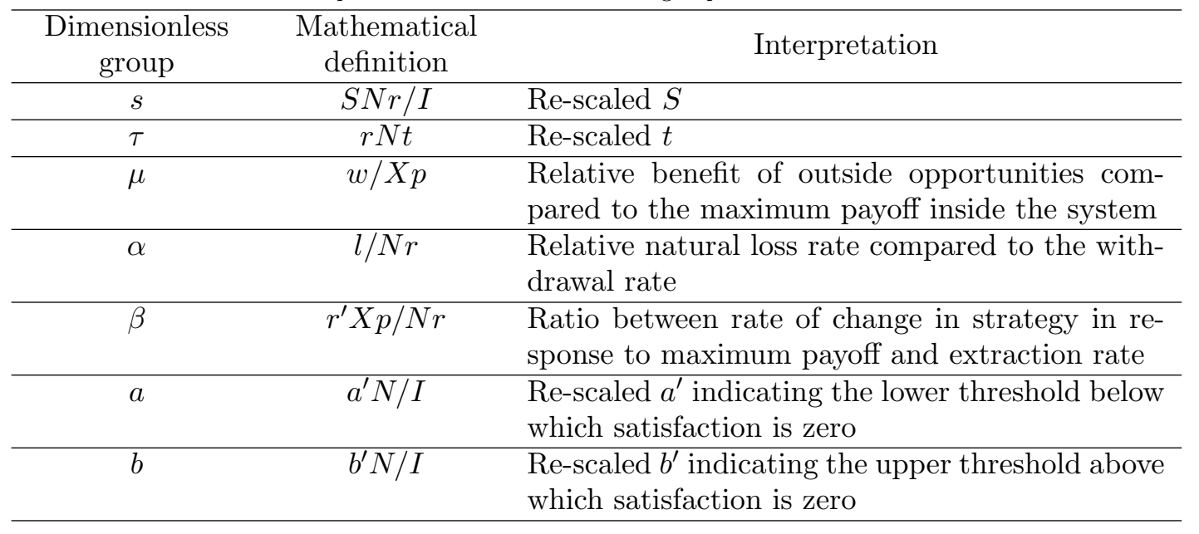
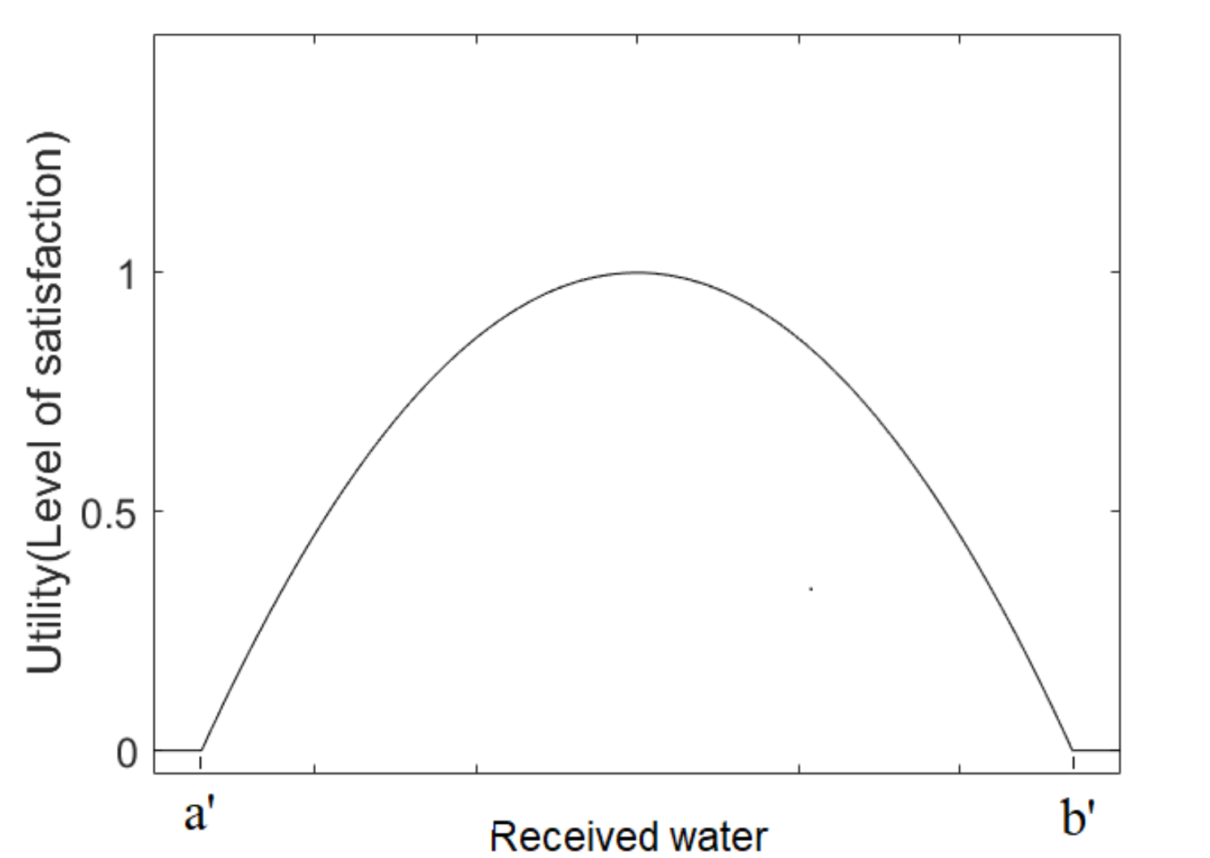
Minimalistic model for a CHWS
A stylized model to capture the key dynamics of a generic CHWS is developed and then…
Rate of change of water storage, S
Inflow
Human extraction
Natural loss
…simplified via non-dimensionalization.
“Water” eq.
“Human” eq.
Rate of change in fraction of efforts spent inside system
Replicator dynamics
Payoff difference between inside and outside the system
Payoff for working inside the system…
…depends on the amount of water received: too little (drought) or too much (flood) is not good.

Slide 3
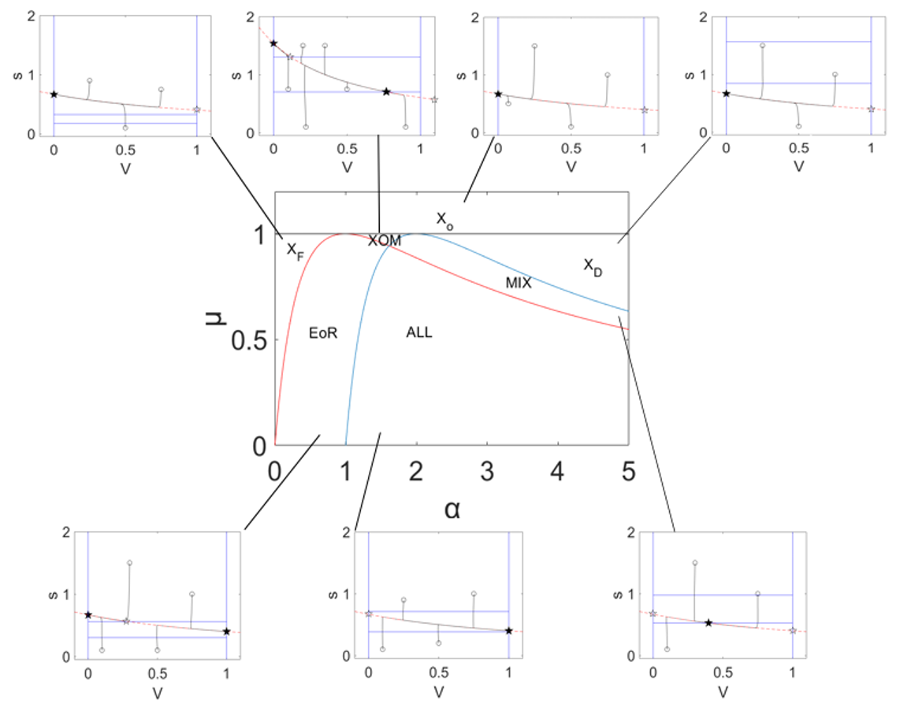
Simple, but rich: 7 regimes
X_{O}: People abandon the system because outside opportunities are too great
X_{D}: Collapse due to droughts
X_{F}: Collapse due to floods
ALL: People invest all efforts in working the system
Outside opportunities are great
EOR: People allocate efforts to either inside or outside.
MIX: People allocate efforts to both inside and outside the system
XOM: People either allocate efforts to both inside and outside or abandon the system
Outside opportunities are poor
Regime boundaries can be clearly expressed in terms of hydrological and socioeconomic factors
Too much water
Too little water

Slide 4
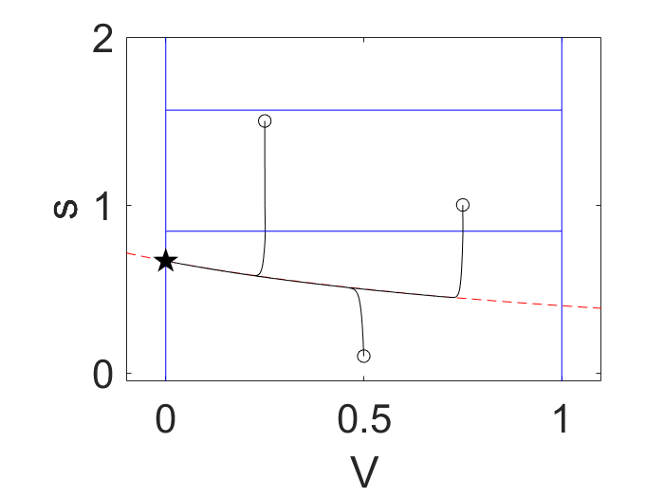
Simple, but rich: 7 regimes
X_{O}: People abandon the system because outside opportunities are too great
X_{D}: Collapse due to droughts
X_{F}: Collapse due to floods
ALL: People invest all efforts in working the system
Outside opportunities are great
EOR: People allocate efforts to either inside or outside.
MIX: People allocate efforts to both inside and outside the system
XOM: People either allocate efforts to both inside and outside or abandon the system
Outside opportunities are poor
Regime boundaries can be clearly expressed in terms of hydrological and socioeconomic factors
Too much water
Too little water

Slide 5
Simple, but rich: 7 regimes
X_{O}: People abandon the system because outside opportunities are too great
X_{D}: Collapse due to droughts
X_{F}: Collapse due to floods
ALL: People invest all efforts in working the system
Outside opportunities are great
EOR: People allocate efforts to either inside or outside.
MIX: People allocate efforts to both inside and outside the system
XOM: People either allocate efforts to both inside and outside or abandon the system
Outside opportunities are poor
Regime boundaries can be clearly expressed in terms of hydrological and socioeconomic factors
Too much water
Too little water

Slide 6
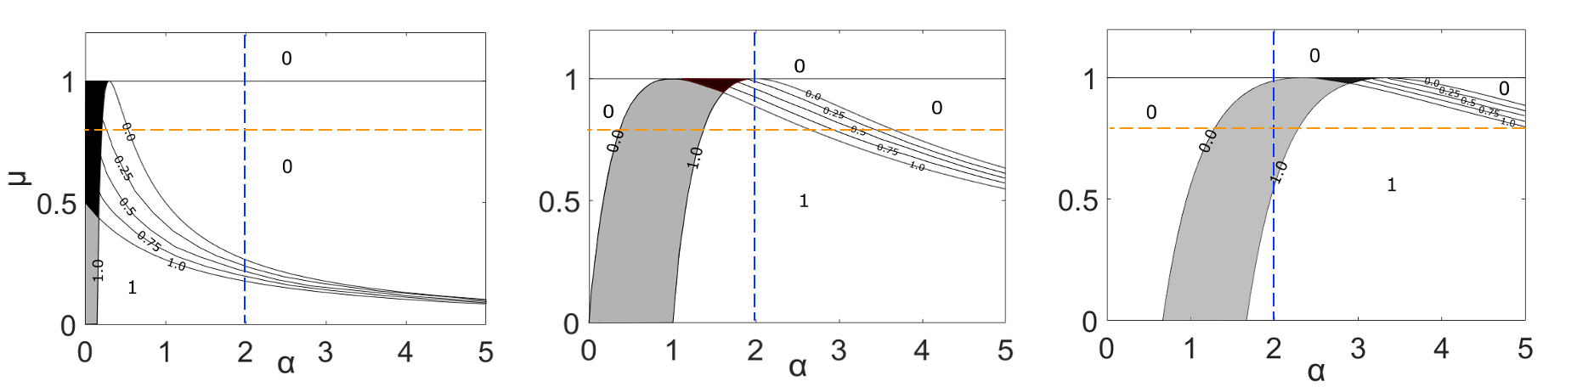
Implications on changes in migration patterns
(a) Low inflow rate
(b) Medium inflow rate
(c) High inflow rate
These are contours of V*, fraction of efforts spent inside the system, which can be thought of as a proxy of migration: lower V* implies greater out-migration. The black and gray areas correspond to the XOM and EOR regimes, both of which have two stable equilibrium points—which one the system would gravitate toward depends on the system’s history. As the inflow rate is altered, the system can undergo transition to a different regime. Such transition has consequences (e.g., the changes in migration patterns implied by changes in V*). The results suggest that changes in migration patterns due to droughts are gradual (ALL→MIX→XD), while those due to floods can be abrupt (ALL→EOR→XF). With understanding of regime boundaries (thresholds) derived from this simple model, one might cope with these changes more effectively.

Slide 7
Implications on changes in migration patterns
(a) Low inflow rate
(b) Medium inflow rate
(c) High inflow rate
These are contours of V*, fraction of efforts spent inside the system, which can be thought of as a proxy of migration: lower V* implies greater out-migration. The black and gray areas correspond to the XOM and EOR regimes, both of which have two stable equilibrium points—which one the system would gravitate toward depends on the system’s history. As the inflow rate is altered, the system can undergo transition to a different regime. Such transition has consequences (e.g., the changes in migration patterns implied by changes in V*). The results suggest that changes in migration patterns due to droughts are gradual (ALL→MIX→XD), while those due to floods can be abrupt (ALL→EOR→XF). With understanding of regime boundaries (thresholds) derived from this simple model, one might cope with these changes more effectively.

Slide 8
Implications on changes in migration patterns
(a) Low inflow rate
(b) Medium inflow rate
(c) High inflow rate
These are contours of V*, fraction of efforts spent inside the system, which can be thought of as a proxy of migration: lower V* implies greater out-migration. The black and gray areas correspond to the XOM and EOR regimes, both of which have two stable equilibrium points—which one the system would gravitate toward depends on the system’s history. As the inflow rate is altered, the system can undergo transition to a different regime. Such transition has consequences (e.g., the changes in migration patterns implied by changes in V*). The results suggest that changes in migration patterns due to droughts are gradual (ALL→MIX→XD), while those due to floods can be abrupt (ALL→EOR→XF). With understanding of regime boundaries (thresholds) derived from this simple model, one might cope with these changes more effectively.
(ALL→MIX→XD),
(ALL→EOR→XF).

