Slide 1

Towards a multi-scale theory on coupled human mobility and environmental change
*
2020 ANNUAL EVALUATION. 26 MAY 2020.
10
1
Book forthcoming
1
Book
under review
Articles published/accepted
10
1
Website set up
1
Interdisciplinary session convened
Manuscripts submitted/under review
7+
Manuscripts under preparation
1
Comprehensive database
MURI W911NF-18-1-0267
HRPO ARL 18-114, ARL 18-115, ARL 18-116

Slide 2
The Call
Topic 8: Modeling Interdependence among Natural Systems and Human Population Dynamics
“Large-scale environmental changes such as floods, earthquakes, and droughts, can drive social mobility, which often precipitates new population migration patterns that in turn affect health, crime, and sociopolitical instability as humans relocate to access critical resources. However, the ability to model, theorize, and predict the interdependencies among environmental change and human social system dynamics remains a scientific challenge.
Successful models of social-natural interdependence must account for the unique temporal/spatial scales of those systems, the factors determining action, and the natural and social constraints placed on those actions. These requirements pose substantial analytic challenges that no single discipline has been able to overcome...”

Slide 3
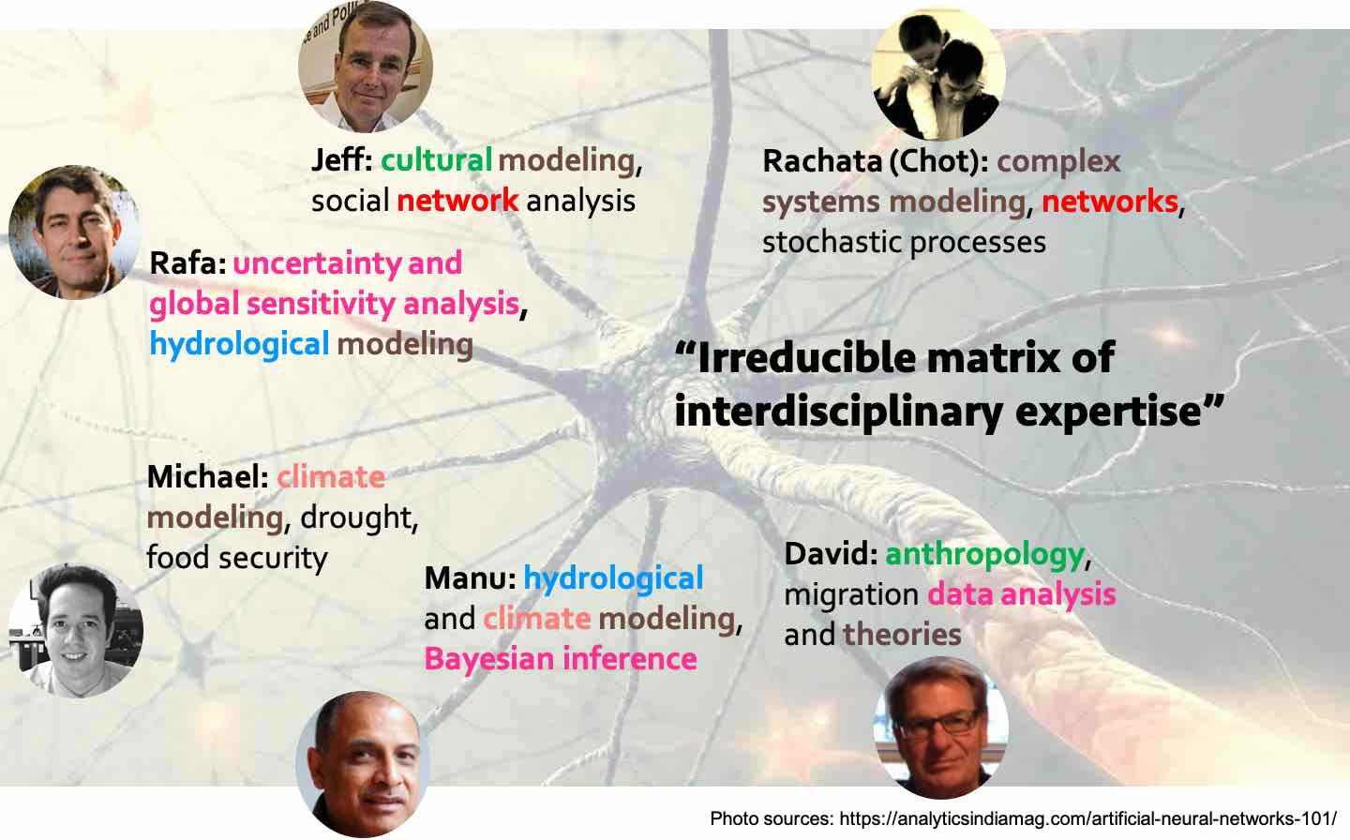
The Team

Slide 4
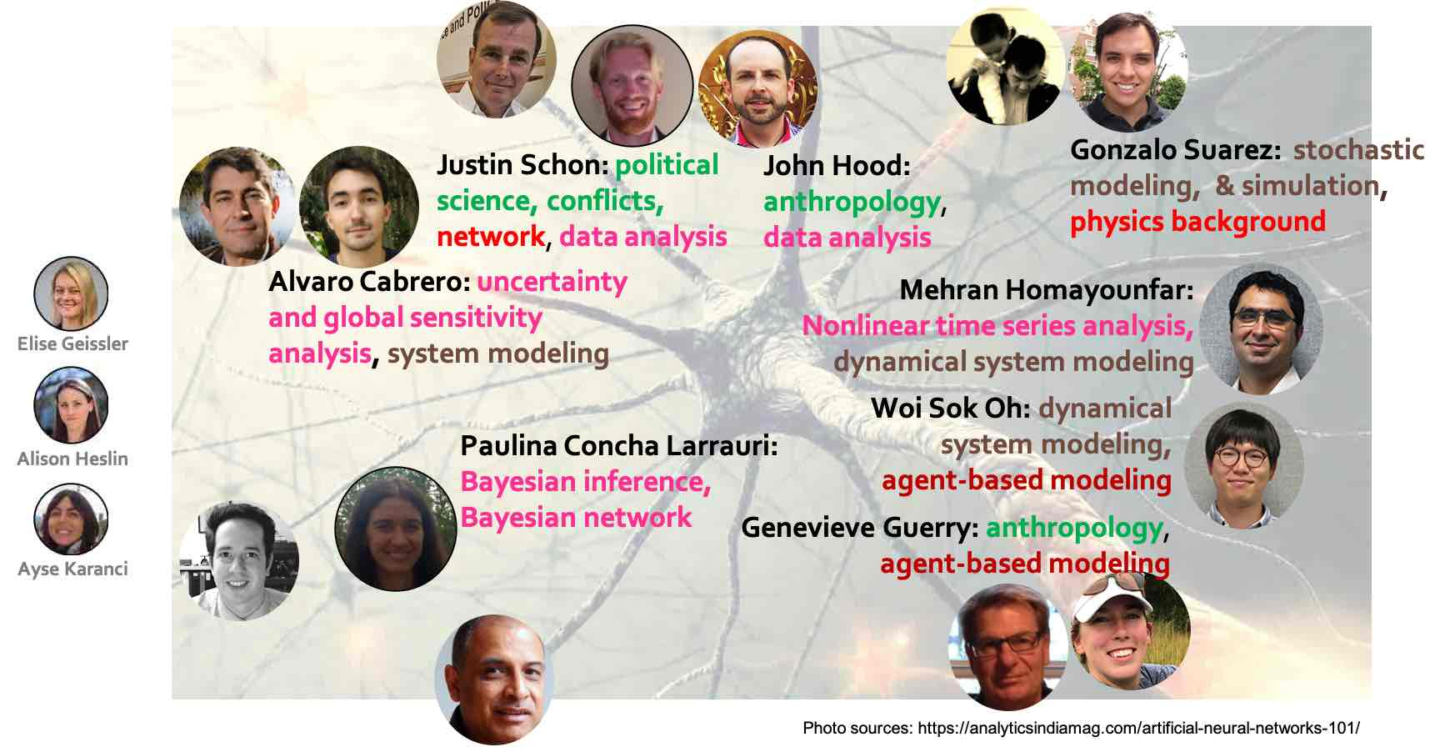
The Team
See Poster
John’s
work
7
See Poster
Mehran’s
work
5

Slide 5

Overarching goal
Towards a multi-scale theory on coupled human mobility and environmental change
The overarching goal of the project is “a modeling platform that is flexible enough to explore different approaches at multiple spatiotemporal scales as well as to strike the right balance of predictive power and facilitation of the development of an integrative theory” of coupled dynamics of environmental change and migration at multiple scales.

Slide 6
Specific goals under the overarching goal
Empirical patterns of migration and their interactions with environmental forcing to be used as foundation to build our models
Advantages and drawbacks of existing data analysis methods, especially as applied to migration data, and how they may be combined to complement one another or integrated/modified into novel methods
Mechanistic models of migration and environmental change where relationships between different social and biophysical factors are clearly laid out and their effects can be rigorously studied
Systematic and flexible protocol to incorporate the empirical patterns into model design and structure
Healthy dissemination of the project’s findings to generate interest and subsequently feedbacks to improve our models and theory
G1
Empirical
patterns
G2
Novel data analysis
G3
Mechanistic models
G4
Patterns + model
G5
Disseminate

Slide 7
How different elements are integrated
GSUA
Migration scenarios
Case studies
Migration theories
Data
GSUA
NLTS
BI
Predictive model
Integrative
Theory
Brainstorming
GSUA
MRQAP
CCM
PMI
BI
[Parameters]
Dynamical system
Agent-based
Climate/
hydrological/
environmental
Concept map
GSUA: global sensitivity/ uncertainty analysis
MRQAP: multiple regression quadratic assignment procedure
CCM: convergent cross mapping
PMI: partial mutual information
BI: Bayesian inference
NLTS: nonlinear timeseries analysis
Causal
networks, relationships, & patterns
Notes:
(Leave this slide up for a minute)

Slide 8
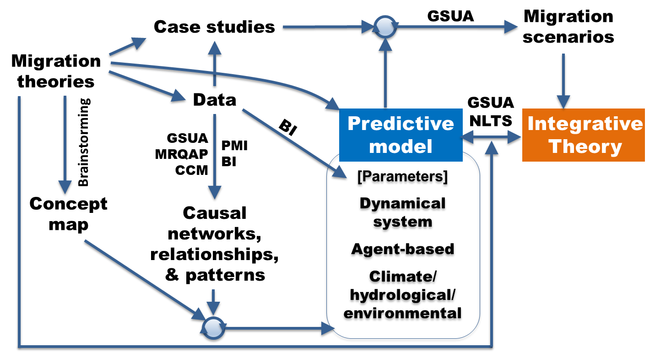
Accomplishments/products and their contributions to the project
10
1
Book forthcoming
1
Book
under review
Articles published/accepted
10
1
Website set up
1
Interdisciplinary session convened
Manuscripts submitted/under review
7+
Manuscripts under preparation
1
Comprehensive database
In the slides that follow, our accomplishments and products will be reported and organized with respect to our specific goals and where they are in the “work flow.”

Slide 9

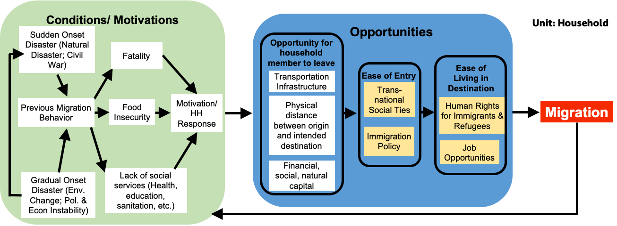

Concept map and stylized facts to guide model development

Slide 10
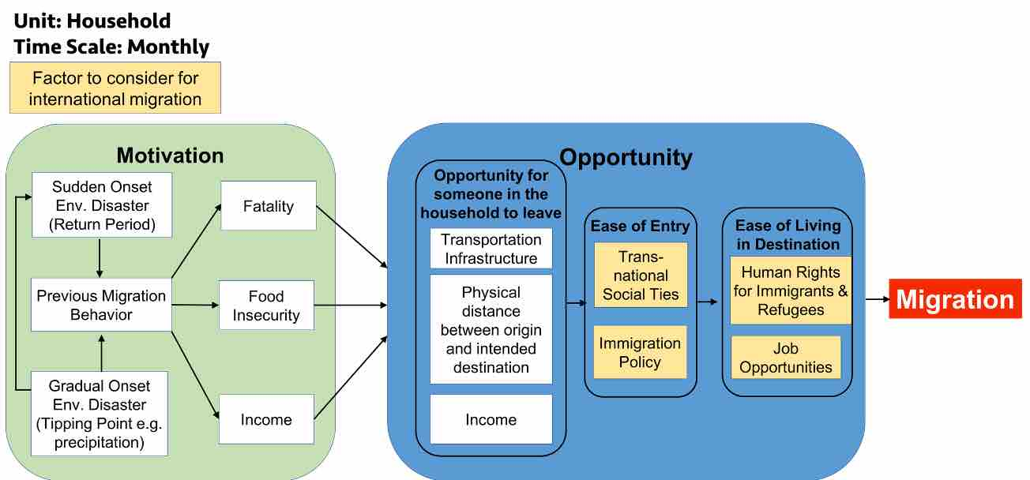













Concept map

Slide 11
Literature Review &
Development of Stylized Facts
From a review of the environmental change-migration literature, we developed 12 stylized facts (propositions we can use to develop and test hypotheses and for modeling)
We considered about how conflict migration, environmental migration, and economic migration influence one another.
We then discussed each of the stylized facts in relation to Syria, Somalia, Honduras, and Puerto Rico.

Slide 12
Literature Review &
Development of Stylized Facts
We included economic migration for two reasons:
  What begins as flight from conflict and environmental crisis often assumes an economic dimension over time.
  Economic livelihoods are key factors in migration behaviors and decisions, particularly multiple livelihoods.
We developed two articles based on the facts and are currently incorporating four of them in an Agent Based Modeling exercise.

Slide 13


The 12 Stylized Facts
Migration is less common than staying put.
People resist migrating as migration becomes common.
Migration builds on previous migration traditions, primarily by means of social networks
Natural environmental, conflict, and economic migration are three of many types of migration.
Return and transit migration result from the above three types of migration.
Uneven migration results from the uneven distribution of environmental change, conflict, and economic conditions.
Short-distance and short-duration migration are more common than long.
Households, as repositories of age and gender relations, influence the composition of migrant populations.
Migration often involves diversifying and reducing risk.
Migration often adds to livelihood portfolios.
Livelihood portfolios that include environmental migration reflect nature-society relationships, including ecosystem services.
All three types of migration lead to managed migration.

Slide 14
Accepted Article: Environmental Change and Human Migration: Stylized facts from Puerto Rico and Honduras
Article accepted for a special issue of the Coastal Management Journal on human responses to hurricanes and other disasters.
Compares responses to Hurricane Mitch (1998) in Honduras to Hurricane Maria (2017) in Puerto Rico, acknowledging distinct social and cultural histories between the two cases.
In Honduras, migration following Mitch founded a new migration tradition, but in Puerto Rico, previous migration traditions were instrumental in how people responded to the storms and their aftermath.
In both cases, environmental migration facilitated the development and persistence of economic migration, with migration assuming a key position within household livelihood constellations.

Slide 15
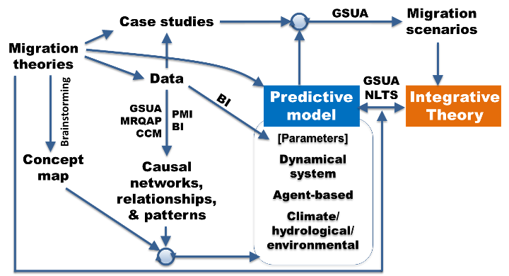
Multilayer Network Models of Global and Regional Refugee flows
6
See Poster
for more
work by Justin
Justin Schon
Jeffrey Johnson

Slide 16
Multilayer Global Network Models Over Time
How does the global refugee flow network form and evolve over time?
We first account for structural network dependencies in our regression analysis with the quadratic assignment procedure (QAP).
Recognizing that refugee flows are influenced by many factors, we identify clusters of international networks with similar trends in how they affect refugee flows with k-means clustering analysis. This allows us to show quantitatively how drivers of refugee flows can be grouped into migration networks and inter-state networks of amity and animosity.
Our time series of results from 1991-2016 also allows us to observe how the global refugee network, as well as prominent drivers of that network, changed after the Arab Spring.

Slide 17
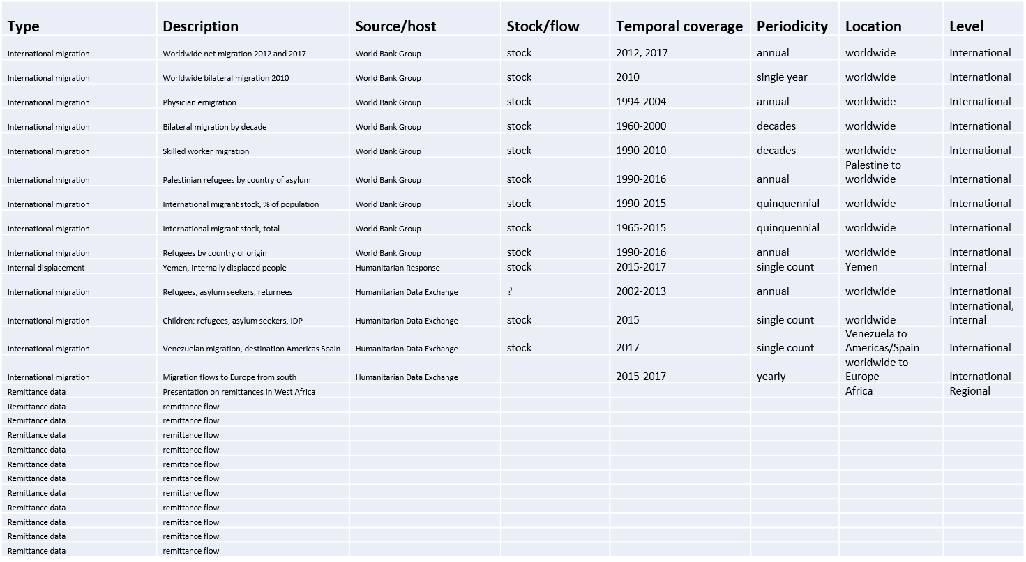
Database

Slide 18
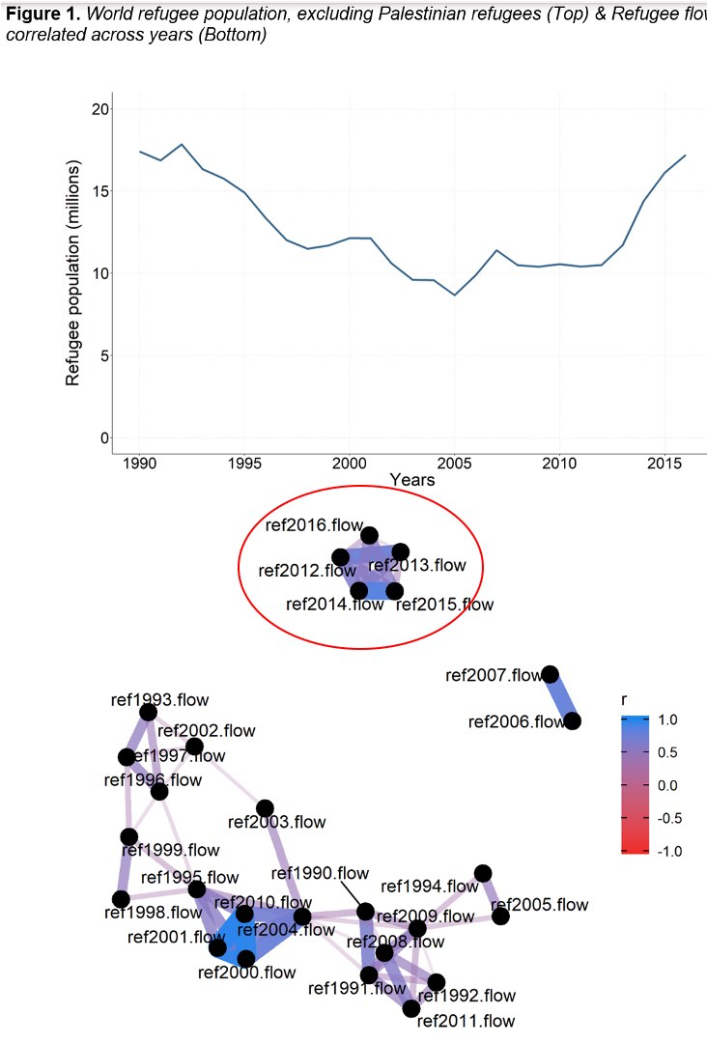
Flows Over Time
Figure 1 shows the post-Cold War refugee flows. At the end of the Cold War, the breakup of the Soviet Union and Yugoslavia, collapse of the Somali state, and other conflicts drove the world’s refugee population over 15 million.
As the 1990s proceeded though, conflicts progressively ended. The figure shows that the global refugee population progressively fell from 1990 to 2005
From 2005-2007, the world’s refugee population increased, before remaining relatively constant until 2012.
During the 2012-2016 time period, the world refugee population under UNHCR’s mandate increased substantially, from roughly 10.5 million to 17 million refugees

Slide 19
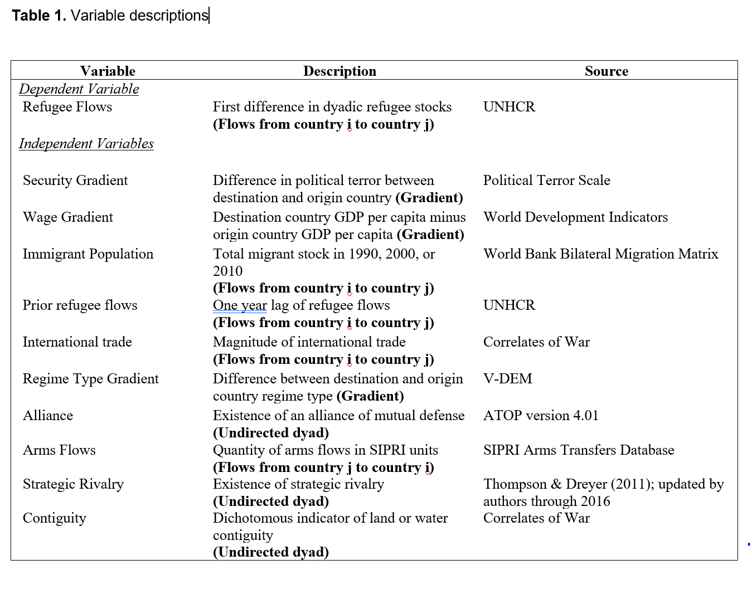
Hypothesized Drivers of Refugee Flows
The basic linear model for square matrix data considered here is:
Y =βX+Zγ +E,
where Y, X, and E are n×n matrices, β is a scalar, Z is an n×n×q array, and γ is q×1.The diagonals of the matrices are always ignored.
The null hypothesis is H0:β =0.
(Dekker, Krackhardt, and Snijders 2007)

Slide 20
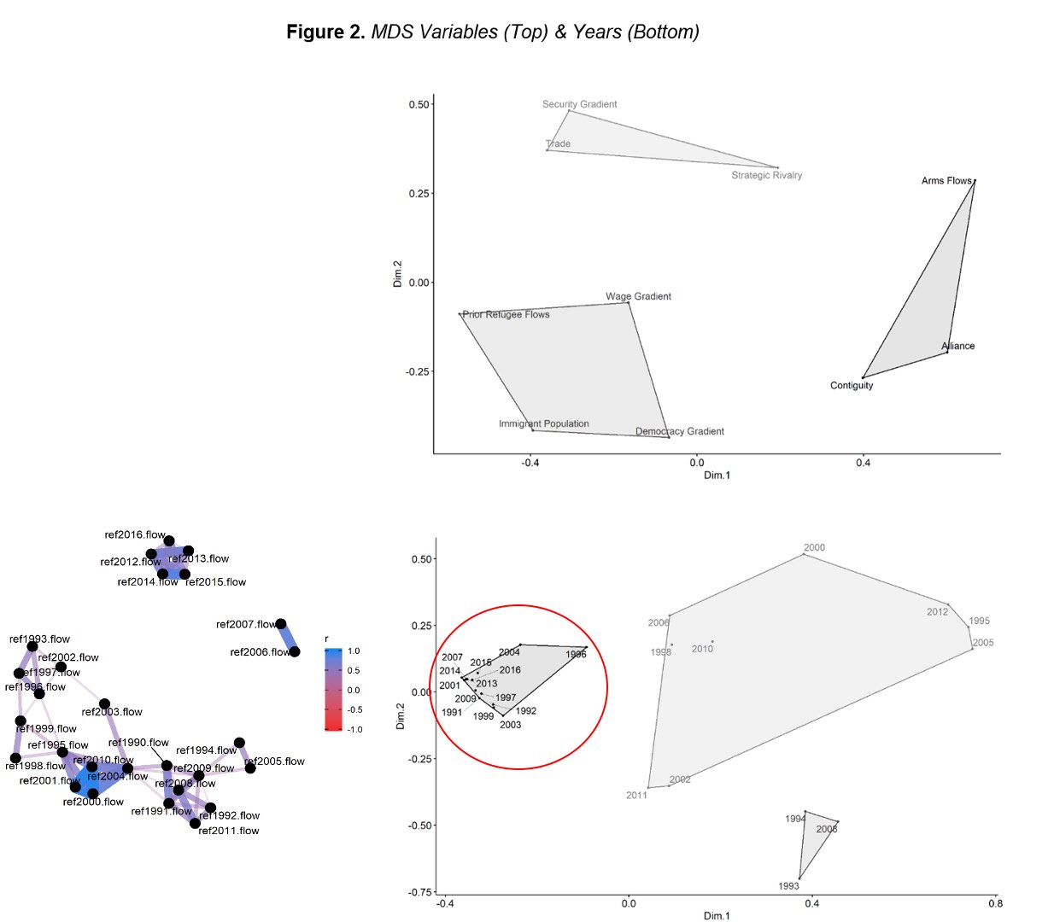
Categories of Variables and Years
K-means clustering analysis shows two key insights:
  Variables can be grouped into Networks of Amity (Contiguity, Alliance, Arms Flows); Networks of Animosity (Security Gradient, Trade, Strategic Rivalry); and Migration Networks (Prior Refugee Flows, Wage Gradient, Democracy Gradient, Immigrant Population)
  2013-2016 cluster into a distinct group from 2010-2012.
Refugees moved through new dyads starting in 2012. The drivers of those flows shifted by 2013.

Slide 21
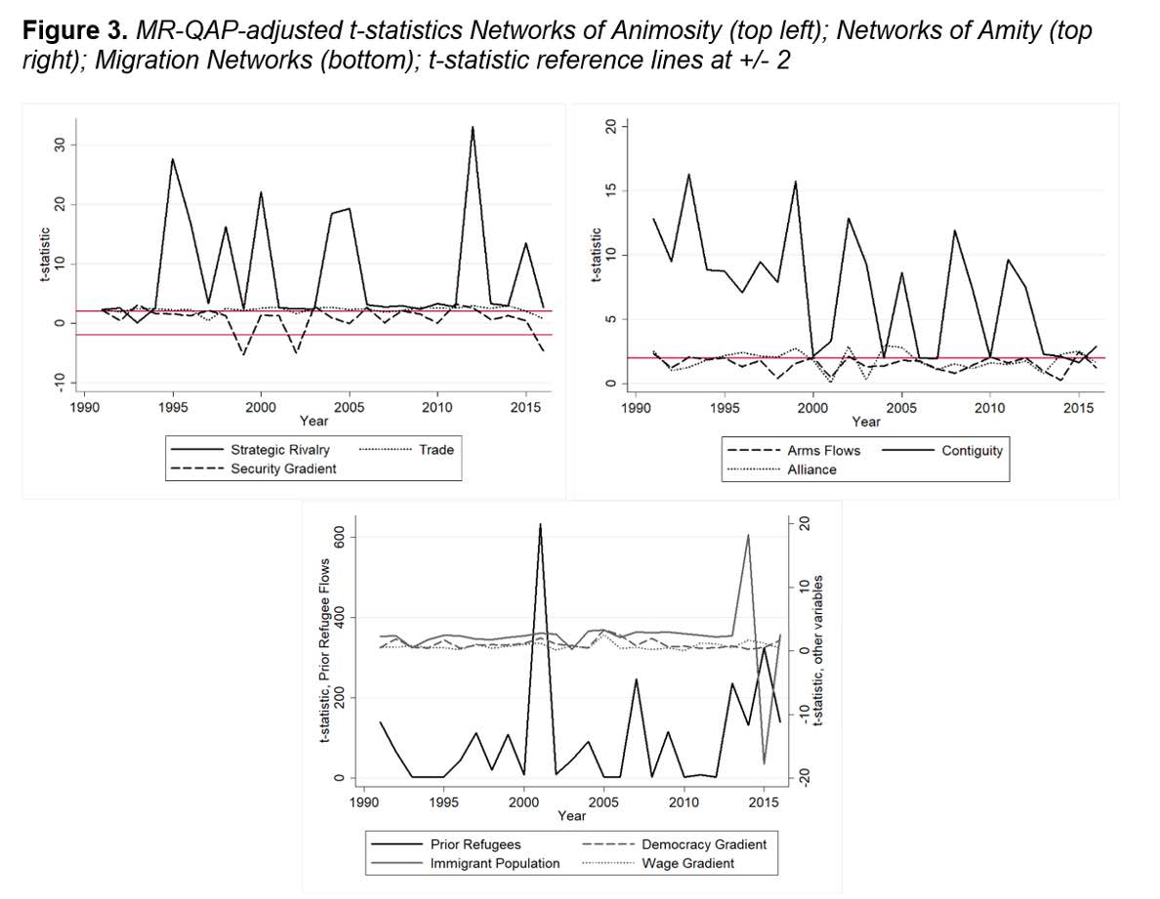
Time Series of Variables by Group
Networks of Animosity: Strategic Rivalry is by far the strongest driver.
Networks of Amity: Contiguity is by far the strongest driver.
Migration Networks: Prior Refugee Flows are by far the strongest driver of Refugee Flows, but aggregate migration networks are also notable.

Slide 22
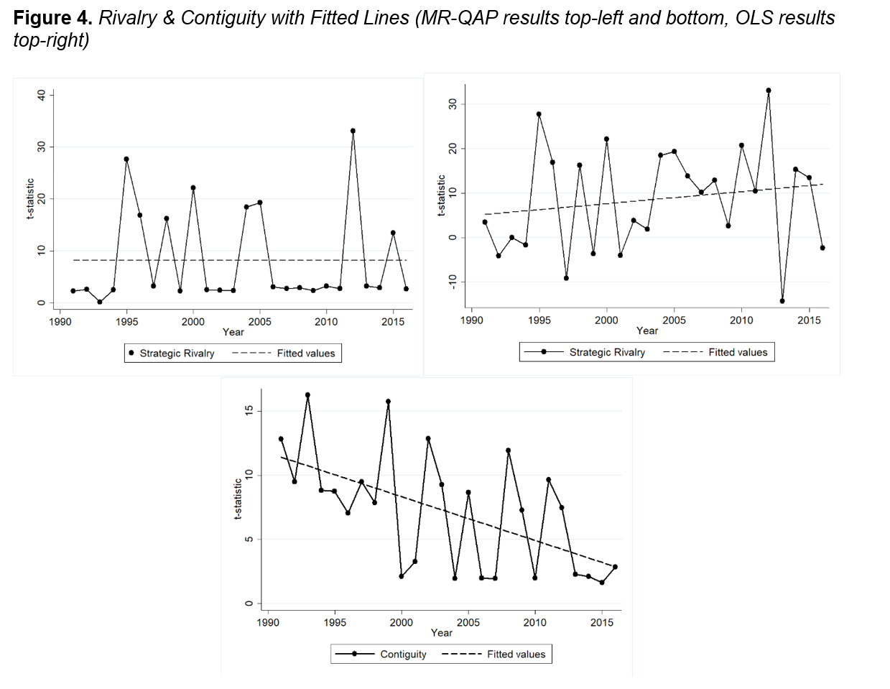
Trends in Rivalry and Contiguity
Strategic Rivalry affects Refugee Flow dyads and the structure of refugee flows networks.
Contiguity becomes less important over time.
  Consistent with April 2020 World Bank working paper on refugee flows 1987-2017 that uses spatial and econometric methods.

Slide 23
Multilayer Global Network Models Over Time
Our work has demonstrated the value of explaining refugee flows as a multi-layer network. An analysis that incorporates multiple overlapping networks allows us to account for many kinds of network dependencies.
Considering correlations between the sets of existing refugee flow directed dyads in each year, we observe a noisy process from year to year. The 2012-2016 time period, however, stands out as a period with highly inter-correlated refugee flows across years. The models show that refugee flows vary based on variation in factors related to international migration networks, networks of animosity, and networks of amity.
Additionally, the influence of contiguity in the models has declined over time, reflecting shits in refugee movement patterns.

Slide 24
Regional Dynamics as Ego networks
Ego networks allow us to analyze refugee flow networks in specific regions.
Refugee flow ego networks include an origin country of interest (ego) and its destination countries (alters). We include refugee flows between alters and from alters back to egos (although these are uncommon) in our ego networks.
We analyze the refugee flow ego networks of the top 10 refugee producers (capturing over 90% of refugee flows) in each year 2011-2016.

Slide 25
Refugee Flows 2011-2016: Stable Origins & Changing Destinations
Comparing the sets of top 10 origin and top 10 destination countries in each year, the set of origin countries is relatively constant. The set of destination countries varies.
Refugees are moving longer distances. While moving to non-contiguous countries, migration infrastructure becomes especially important.
Migration infrastructure includes: 1) State policies; 2) Migrant social networks; and 3) Migration industries
*Labor markets are part of this for international migration, not for refugee flows.

Slide 26
Refugee Flow Ego Networks
2011 | 2012 | 2013 | 2014 | 2015 | 2016
Haiti | Mali | Mali | Ukraine | Ukraine | Nigeria
Ivory Coast | Ivory Coast | CAR | Nigeria | Nigeria | CAR
DRC | DRC | DRC | CAR | CAR | Burundi
Burundi | Somalia | Somalia | DRC | DRC | Eritrea
Somalia | Ethiopia | Eritrea | Somalia | Burundi | Sudan
Eritrea | Eritrea | Sudan | Eritrea | Rwanda | South Sudan
Sudan | Sudan | South Sudan | South Sudan | Eritrea | Iraq
Afghanistan | Syria | Syria | Syria | South Sudan | Syria
China | Afghanistan | Afghanistan | Afghanistan | Syria | Afghanistan
Myanmar | Myanmar | Myanmar | Pakistan | Afghanistan | Vietnam
91% of TOTAL | 94% of TOTAL | 97% of TOTAL | 95% of TOTAL | 92% of TOTAL | 93% of TOTAL

Slide 27
Classifying Refugee Flows, 2011-2016
Two techniques:
MR-QAP on each network & Qualitative Classification of Results
Multi-Dimensional Scaling, using coefficients from linear regression

Slide 28
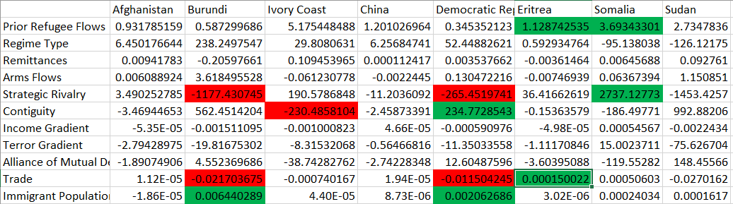
Cluster dendrogram for 2011

Slide 29
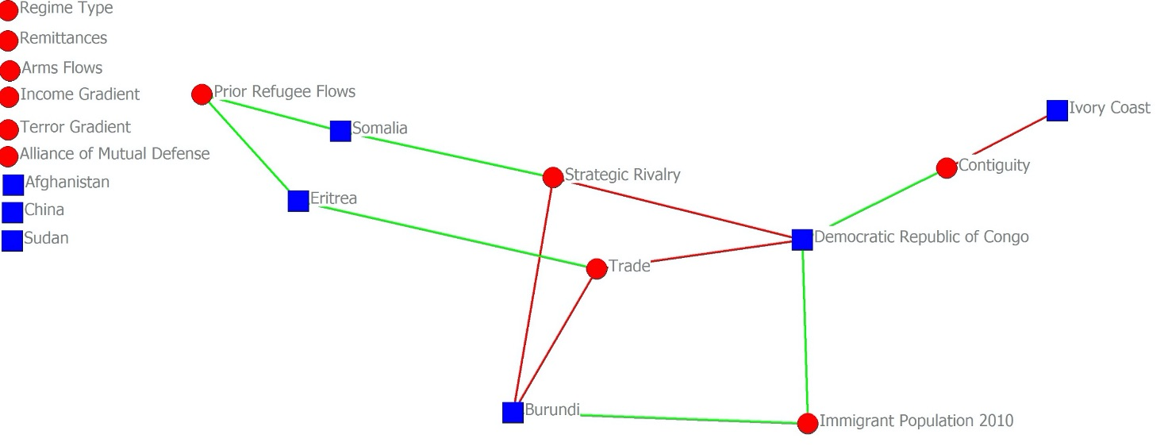
Network of Significant Variables 2011

Slide 30
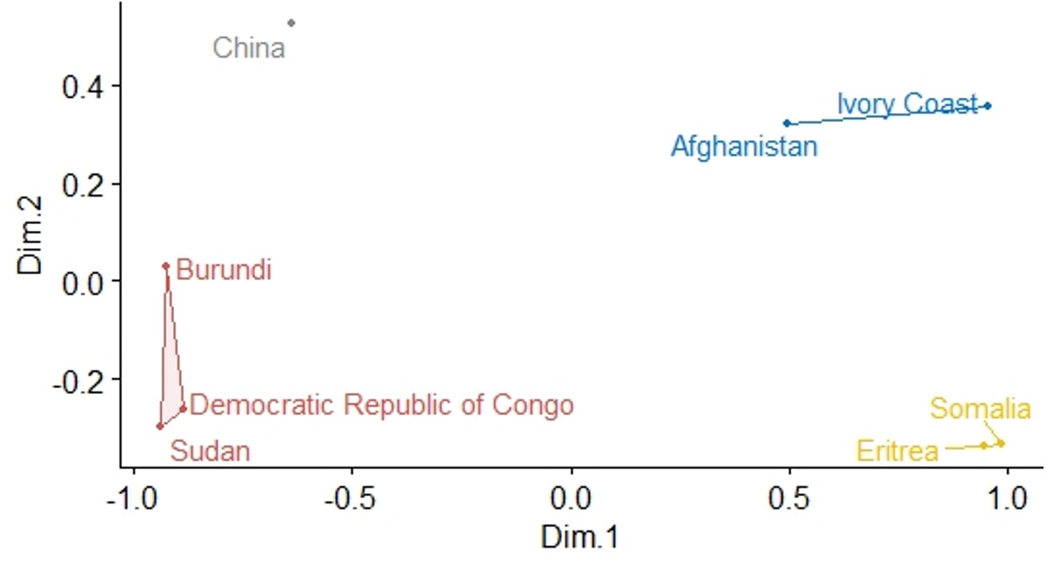
Multi-dimensional scaling clusters for 2011

Slide 31
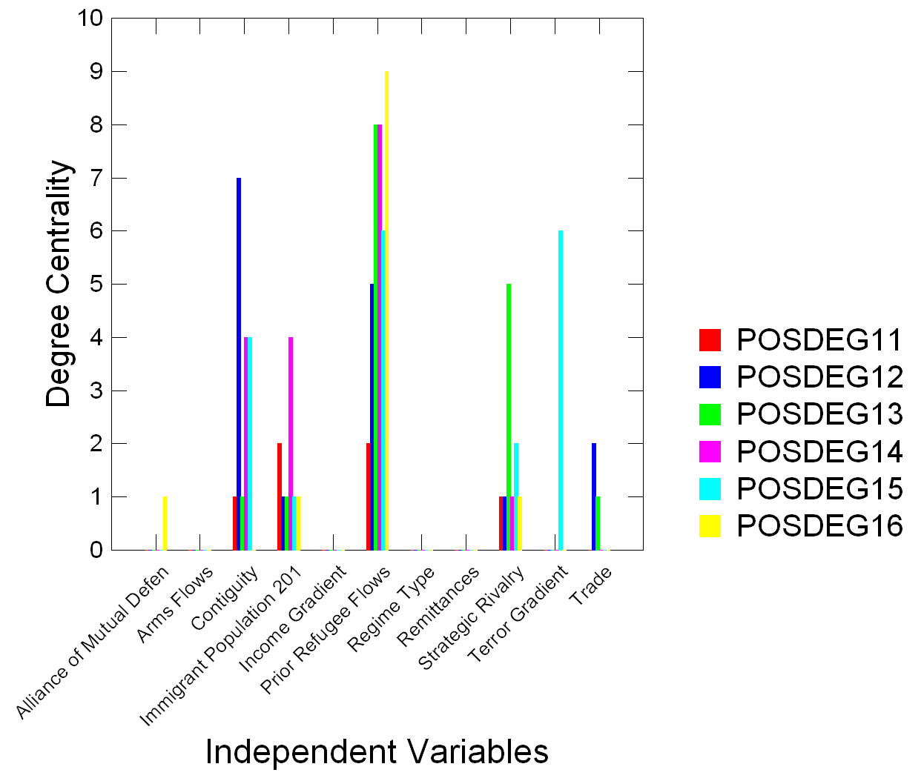

Slide 32
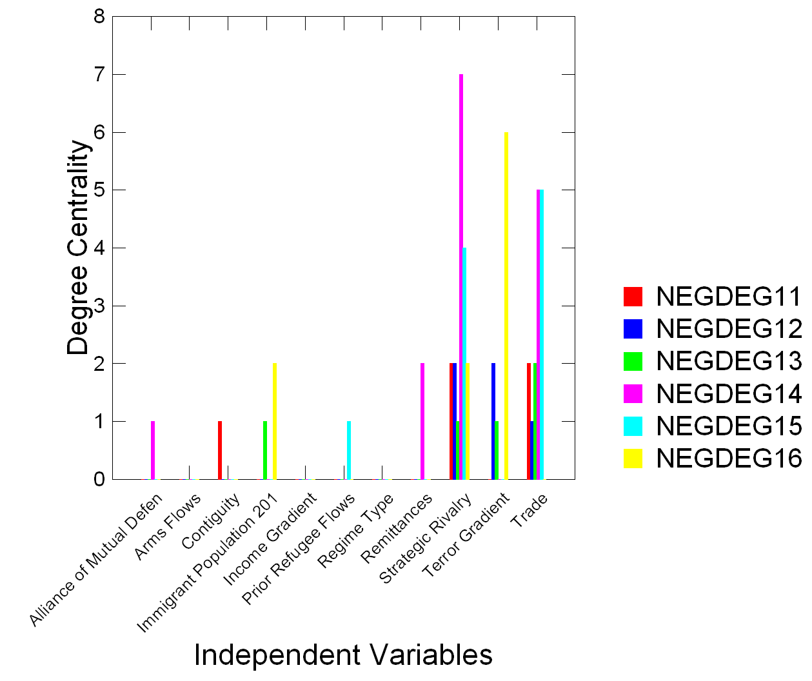

Slide 33
Conclusions
Analyses of global refugee flow trends mask important regional variation.
Refugee flows from year to year are dynamic
Previous year refugee flows, contiguity, seeking security and differences in trade are the primary factors explaining refugee flows
Regional refugee flows most consistently break down into refugees just fleeing to the closest country (Escaping Refugees) that is safer or refugees who respond to geopolitics (Rivalry & Refugees).
As in the global models, the influence of contiguity is declining even when looking at the regional level.
Our network models corresponds to recent World Bank models that corroborate our findings on declines in contiguity using using spatial analysis and econometric methods.

Slide 34
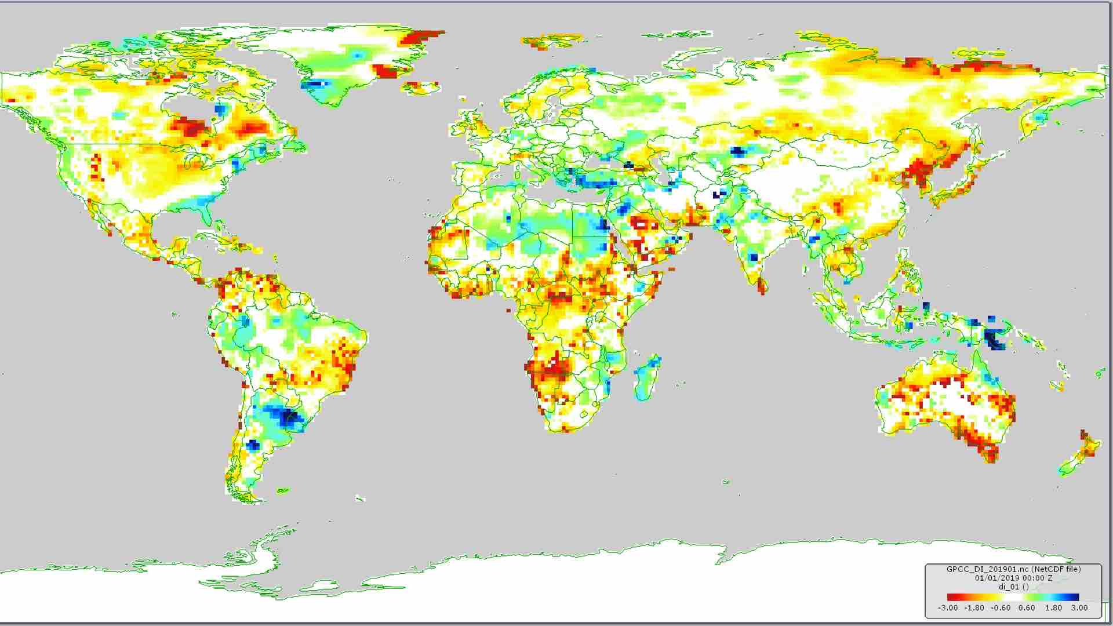
Next Steps
Begin to examine the environmental drivers of both refugee flows and migration.

Slide 35
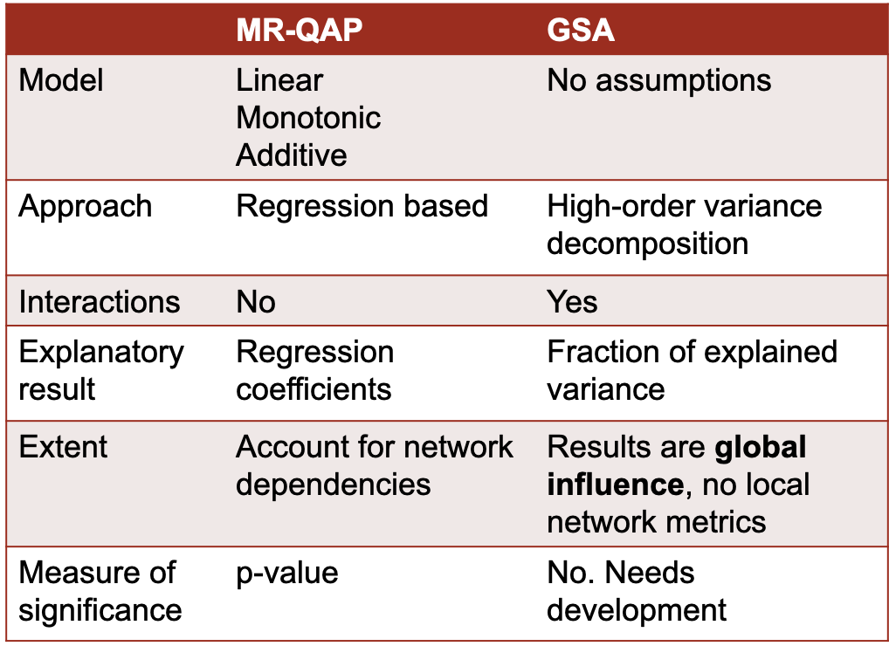
Combining global sensitivity analysis and quadratic assignment procedure to improve explanations of complex network processes: A case of global refugee networks
Alvaro Carmona-Cabrero
Justin Schon
Jeffrey Johnson
Rachata Muneepeerakul
Rafael Muñoz-Carpena

Slide 36
Introduction
Migration and refugee flows are network processes
Usually, network analysis methods (like MR-QAP) make strong assumptions about functional relationships within these networks
Global Sensitivity Analysis (GSA):
  High-Dimensional Model Reduction technique (HDMR), variance decomposition of system outcome
  not been used for real world data analysis but, provided sufficient data is available (Big Data), it can provide a “model-free” complementary approach to existing methods.
Test case: global refugee flows in 2016

Slide 37
Comparison between MR-QAP and GSA
Methods are very complementary for the study of Migration
Each method has
advantages & limitations:
 | MR-QAP | GSA
Extent | Account for network dependencies (+) | Results are global influence, no local network metrics
Model | Linear Monotonic Additive | No assumptions (+)
Approach | Regression based | High-order variance decomposition (+)
Interactions | No | Yes (+)
Explanatory result | Regression coefficients | Fraction of explained variance (+)
Measure of significance | p-value (+) | No. Needs development

Slide 38
Data set
For the study case a set of social variables has been used
Ideally, environmental drivers would be considered
Addition of variables that account for fixed effects:
  “Origin is” and “is neighbor of” for top 10 refugee-producer countries
Network (variable) | Source
Refugee flows (dependent variable) | UNHCR
Prior refugee flow | UNHCR
Relative safety | Political Terror Scale
Wage gaps | World Development Indicators
Remittances | World Bank
Total migration stock | World Bank bilateral migration matrix
International trade | Correlates of War
Regime type difference | V-DEM
Alliances of mutual defense | ATOP version 4.01
Arms flows | SIPRI Arms Transfer Database
Strategic rivalry | Thompson & Dreyer (2007)
Contiguity | Correlates of War
Origin is X | Network topology
Is Neighbor of X | Network topology
k = 31

Slide 39
Methodology
Transformation (log) of skewed variables (refugee flows, trade, immigrant population, remittances, arms flows)
Categorization of k=31 input variables (2-5 categories per variable)
Variance decomposition of response variable, V(Y) (refugee flows):
$$V_{i}={Var}_{X_{i}}\left[E_{\sim X_{i}}\left[Y|X_{i}\right]\right]=\sum_{x}{{\left(E_{\sim X_{i}}\left[Y|X_{i}=x\right]\right)}^{2}P\left[X_{i}=x\right]−E{\left[Y\right]}^{2}}$$
$$V_{i,j}={Var}_{X_{i,j}}\left[E_{\sim X_{i,j}}\left[Y|X_{i,j}\right]\right]=\sum_{x,y}{{\left(E_{\sim X_{i,j}}\left[Y|X_{i}=x, X_{j}=y\right]\right)}^{2}P\left[X_{i}=x, X_{j}=y\right]−{E\left[Y\right]}^{2}−V_{i}−V_{j}}$$
  First (direct) order effects: S_{i}=V_{i} / (V(Y))
  Total order effects: S_{Ti} ( i.e. for factor X₁)= S₁ + S₁₂ + S₁₃ + … + S₁₂₃ + …
  Interactions (higher order effects) : S_{Ti} – S_{i}

Slide 40
Comparison of results
MR-QAP provides directionality of significant variables
Discrepancies explained by:
  GSA only finds “globally” important factors
  GSA ability to capture non-linear dynamics (Trade, highly-interactive?)
  GSA not picking up rare occurrence or categorical inputs with extremely uneven distribution (Origin and no alliance variables)
High interactions for some variables (Neighbors and contiguity). This could be spurious and not significant when tested
 | MR-QAP Important (+/-) | MR-QAP not Important
GSA Important (Si > 0.03 & STi > 5%∑STi) ∑STi = 5.65 | Prior Refugee Flows (+) (0.52) (0.54) Democracy Gain (+) (0.03) (0.49) Relative Safety (+) (0.08) (0.49) Immigrant Population (+) (0.08) (0.45) | Trade (0.03) (0.44)
GSA not Important | No alliance (+) (<0.02) (0.29) Origin is Syria (+) (0.03) (0.13) Origin is Afghanistan (+) (<0.01) (0.08) Origin is Burundi (+) (<0.01) (0.11) Origin is CAR (+) (<0.01) (0.04) Origin is Eritrea (+) (<0.01) (0.05) Origin is Iraq (+) (<0.01) (0.08) Origin is Sudan (+) (<0.01) (0.06) | Gdppc gradient (0.03) (0.21) Contiguity (<0.02) (0.42) Neighbors (<0.02) (<=0.35) Origin is South Sudan (<0.01) (0.05) Rivalry (<0.02) (0.15) Rest of countries matrixes (<0.02) (<0.02) Remittances Arms Flows Inverse
=
≠
≠
=
GSA significance needs to be explored. Needed to separate “noise” (unexplained variance)

Slide 41
Conclusions
GSA and MR-QAP proved complementary to understand refugee flows
GSA “model-free” allows to confront the results from dynamics of observed refugee flows/migration signals to those of large data sets.
MR-QAP network based, locally important variables in network
Next steps: GS-QAP
Combine the two methods to obtain a new one, GS-QAP:
  Assumptions free + stating significance of results
  Significance could allow to distinguish interactions due to unexplained variance
Use this new method to determine variables which are good predictors for migration/refugee flow patterns
GS-QAP will serve as evaluation and corroboration of MURI modelling efforts

Slide 42
Combining analyses to make sense of environmental-migration data: Somalia case
3
Paulina Concha Larrauri
Justin Schon
Upmanu Lall
See Poster
for more
work by Paulina

Slide 43
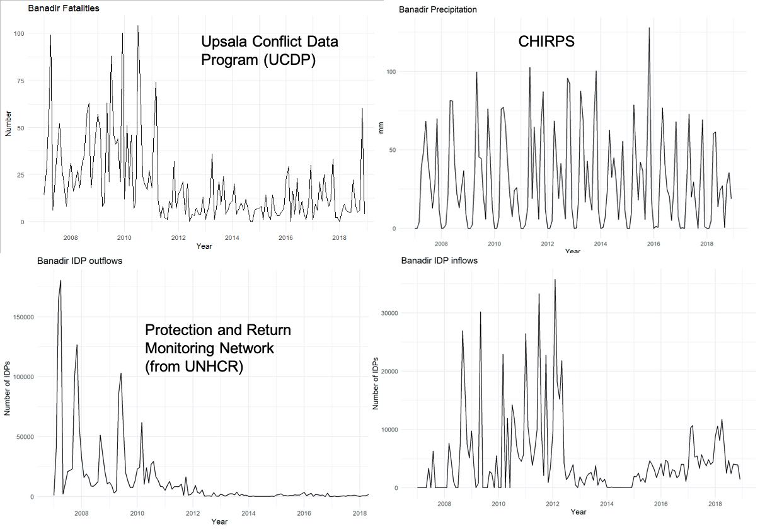
IDP: Violence, water, or both?
Somalia: Floods, droughts, intense conflict, food insecurity , a failed State.
Main surface water sources
Do persistent positive or negative anomalies in precipitation, surface water availability , or violence eventually reach a threshold that induces migration?
Banadir: mostly urban (Mogadishu)
Lower Shabelle: mostly rural (closest to Banadir)
Hiraan: mostly rural (border with Ethiopia)
IDP= Internally displaced people
Notes:
Main message: Disentangling environmental shocks from violent event as triggers of internal displacement is complex, given the inherent feedback loops, non-stationarity, (temporal and spatial variations) . North and South regions have different dynamics. We focused on three regions in the south: Banadir (urban), Lower Shabelle (urban), and Hiraan (rural) This is an example of Banadir is where Mogadishu Is located and an area of intense conflict due to Al Shabaab. There was a period of intense violence from 2007 to 2010. We measure violence as the number of fatalities. We suspect that persistent positive or negative anomalies in precipitation eventually reach a threshold that induces migration. If this is the case, then daily or monthly precipitation is likely to be a poor indicator of the crossing of a threshold of persistent or accumulative effect of precipitation that leads to either flood or drought. Consequently, our approach was designed to identify if cumulative departures from a threshold of precipitation may correlate better with the displacement and violence indicators than precipitation itself

Slide 44
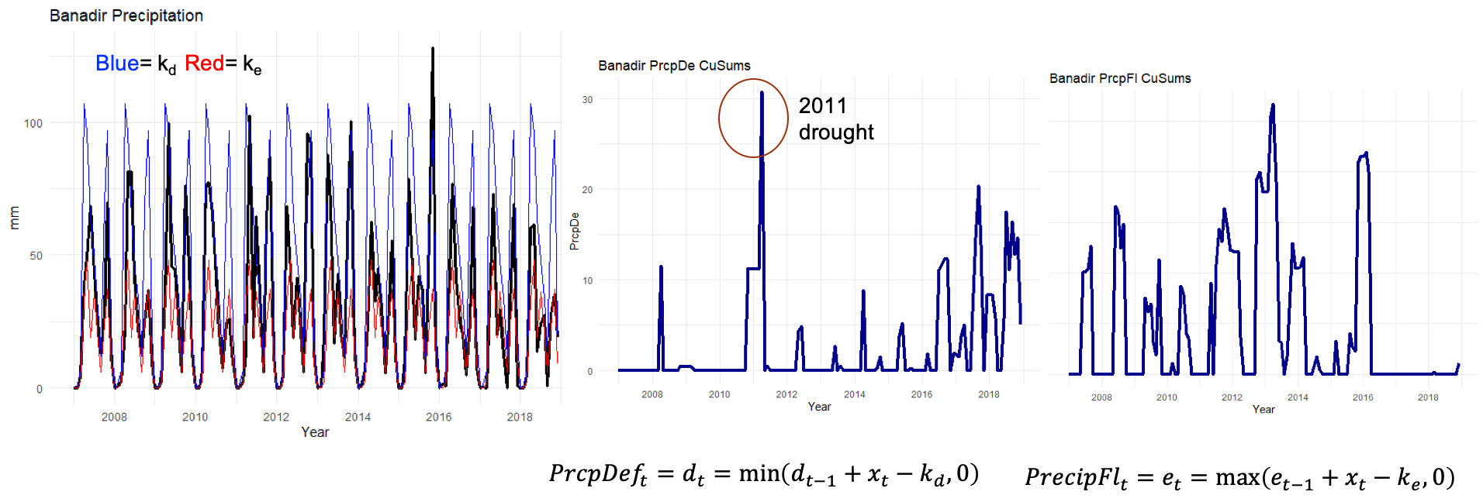
CuSums
The choice of k is important. Here k_{d} is the 25th percentile, and k_{e} the 75th percentile of monthly precipitation.
We do similar transformations with the IDP inflows and outflows, fatalities, and Shabelle river levels at locations close to the study areas.
Notes:
Explain the concept and origin of CuSums

Slide 45
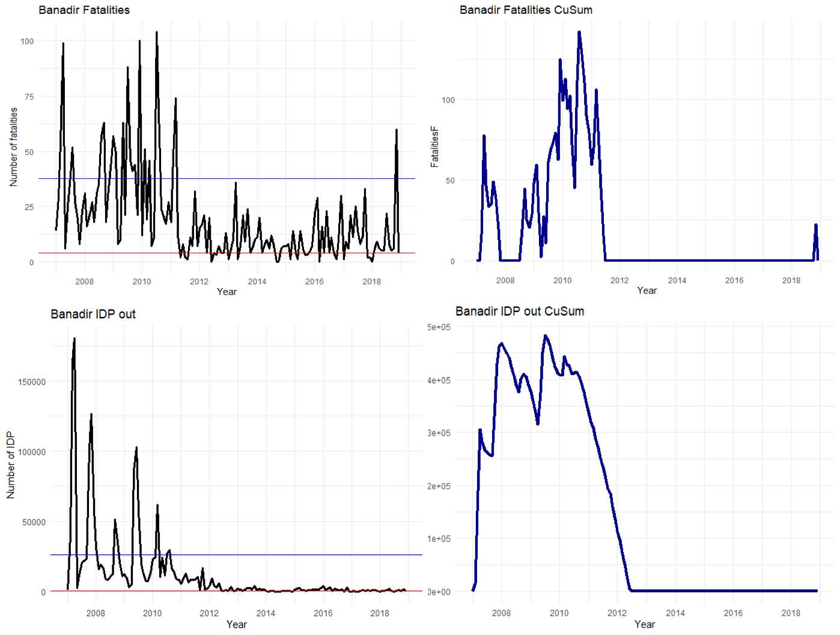

Slide 46
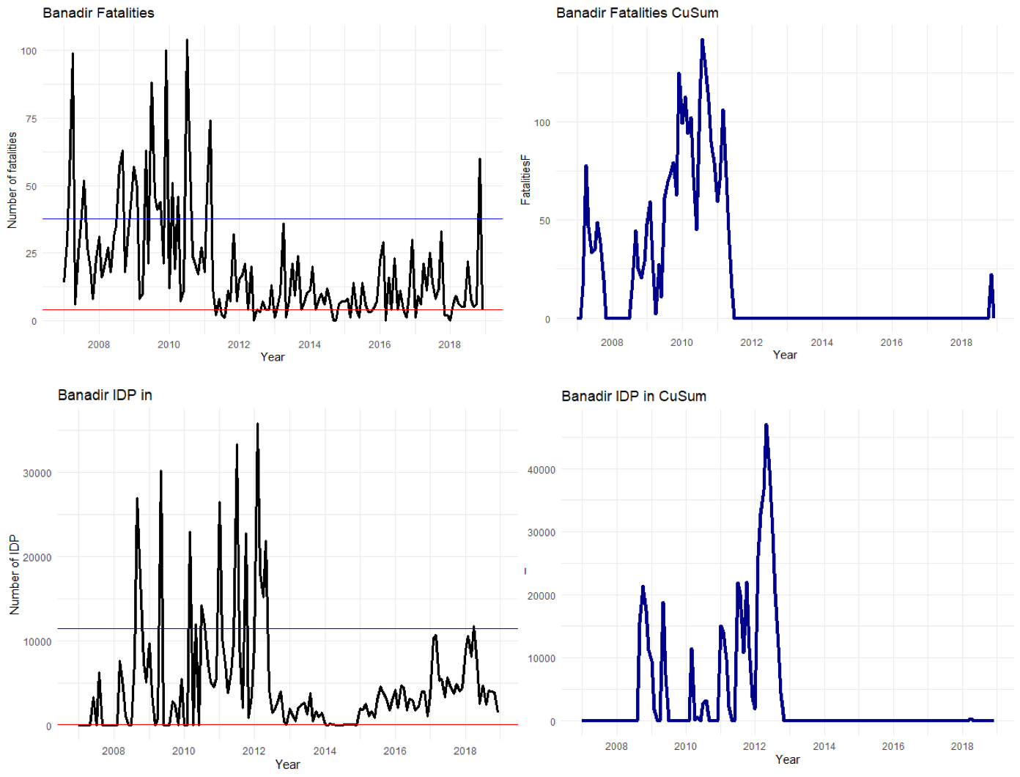
Notes:
We only take the exceedance for these variables k=0.85 in fatalities and k=0.90 in IDPs (inflows and outflows)

Slide 47
Wavelet analysis: checking for persistent signals, shocks, and seasonality
Raw precipitation data. Seasonal cycle
Precipitation deficit index
Notes:
Briefly explain wavelet use

Slide 48
Insights revealed by the analysis
Banadir:
Fluctuations in violence dominate IDP inflows and outflows, relative to drought or flood
Lower Shabelle:
Internal displacement to and from Lower Shabelle was less responsive to its own local violence dynamics than to violence dynamics in nearby Banadir.
Floods, not droughts, appear to be the most likely environmental push factor from Lower Shabelle. Neither floods nor droughts exhibit coherence with violence, so the environmental effect on displacement is most likely a direct effect.
Hiraan:
As in Lower Shabelle, the surge of fatalities pre 2012 in Hiraan is unrelated to droughts or floods because there were no extreme events during this period.
After 2015 there were episodes of surges in fatalities that might be attributed to flood conditions in the Shabelle River.

Slide 49
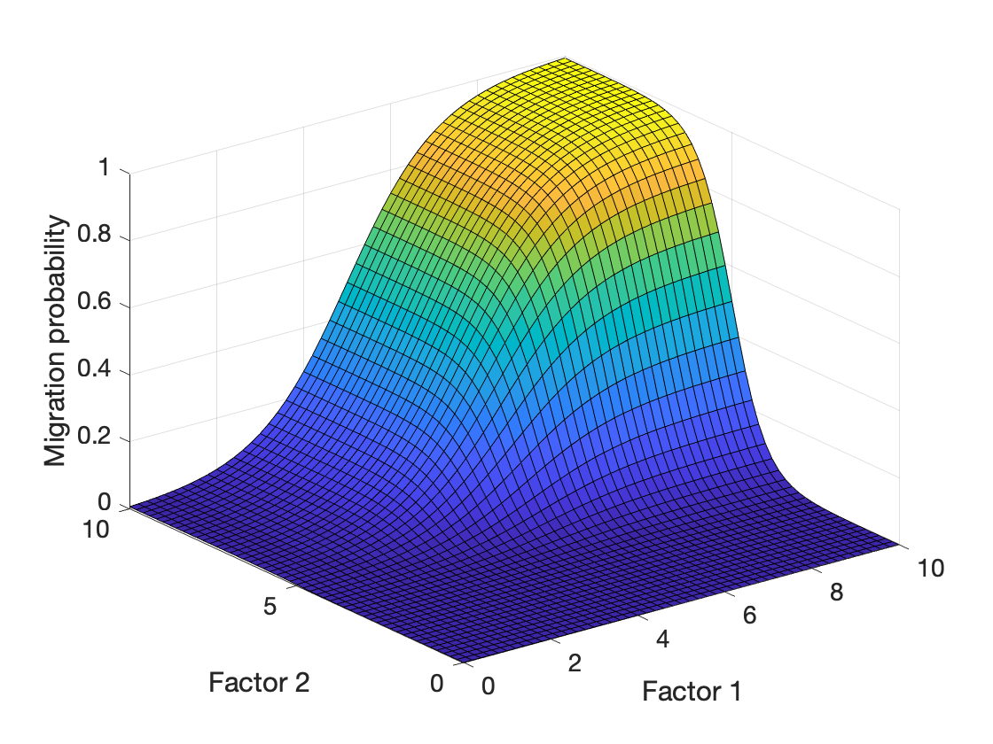
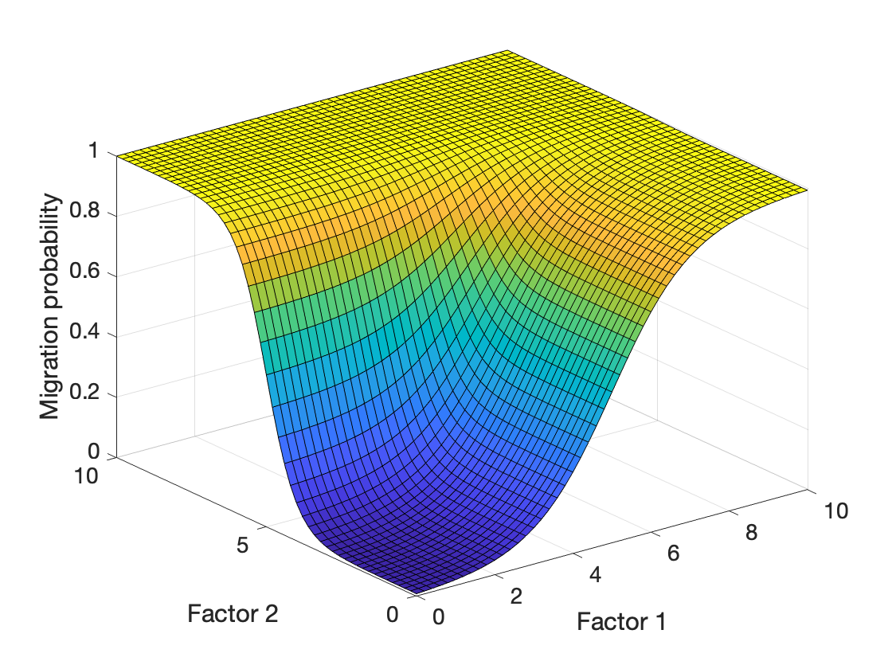
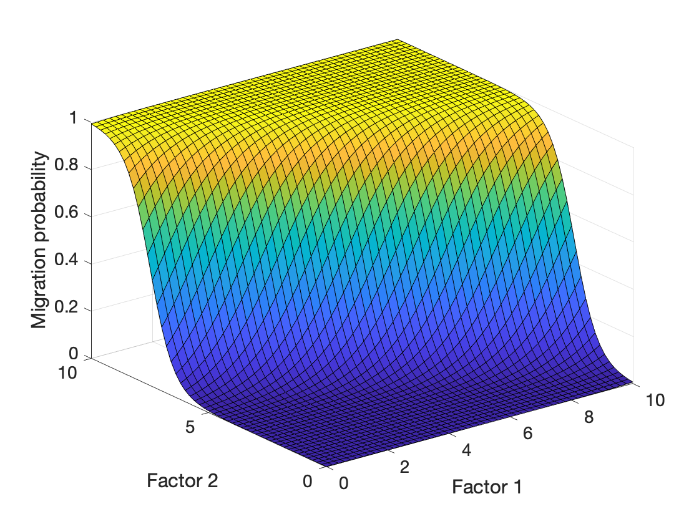


A closer look on how multiple drivers are included in a migration model
Woi Sok Oh
Alvaro Carmona Cabrero
Rafael Muñoz-Carpena
Rachata Muneepeerakul

Slide 50
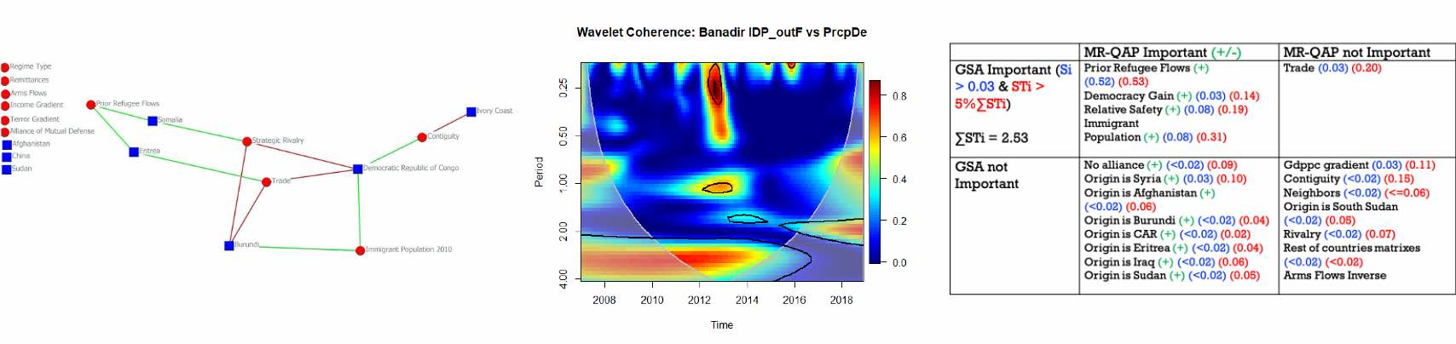
After “what” comes “how”
X and Y are important for migration flows
X + Y
XY
e^{X+Y}
e^{-X-Y}
X?Y
X?Y

Slide 51
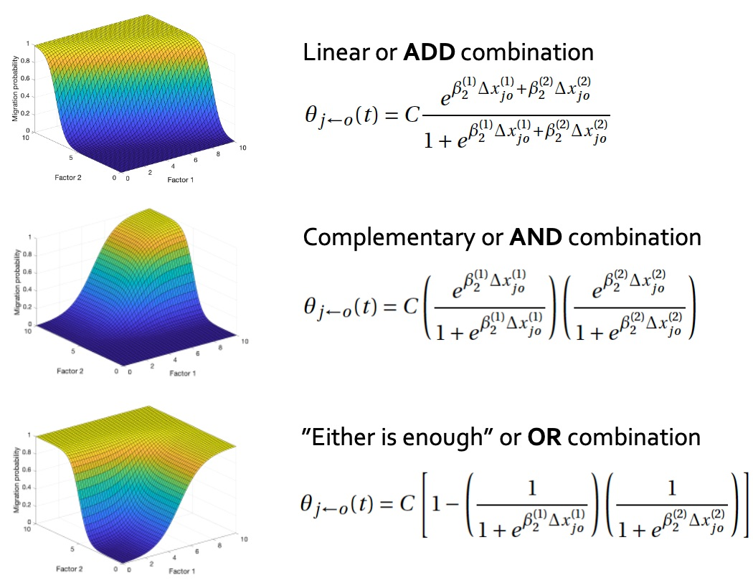
Multiple factors must be incorporated; but how?
configuration
configuration
configuration

Slide 52
Logical operations–AND/OR—may provide clearer links between models and concept/theory
OR
AND
OR
AND
OR
AND
OR
AND
OR
52

Slide 53
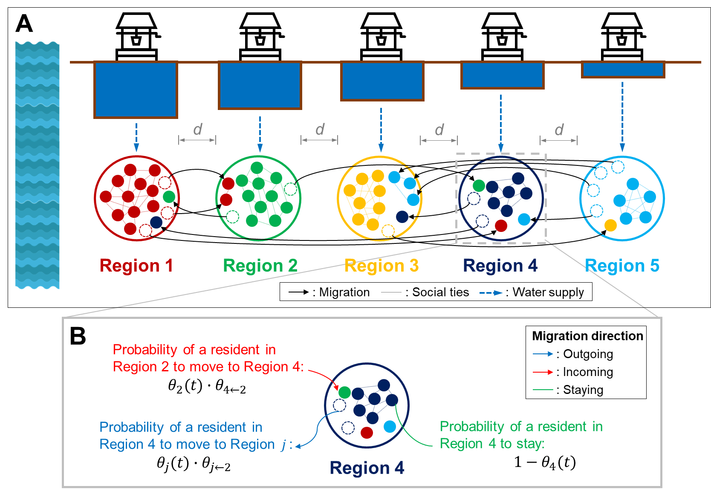
Proof-of-concept ABM
1
See Poster
for more detail
Water-rich
Water-poor
Three factors:
Social factor
Cultural affinity/identity
Environmental factor
Water availability
Distance
Only considered once decision to migrate is made
2-staged decision.
3 config. per stage (ADD/AND/OR) =
9 configurations

Slide 54
How decision factors are configured matters
Population sizes at the 5 cities
(c) is more well-mixed/ diverse than (a) and (b)
2nd stage config.
ADD
AND
OR
(a)
(b)
(c)
ADD
1st stage config.
OR configuration in the first stage seems to lead to highly uncertain outcomes (low predictability) (panels g and h).
Different factor configurations can give rise to quite different diversity patterns, even population patterns appear similar.
(d)
(e)
(f)
AND
1
See Poster
for more detail
(g)
(h)
(i)
OR
Warning:
ABMs are useful but their results are not the easiest to interpret…
(f) and (i) are among the most diverse

Slide 55
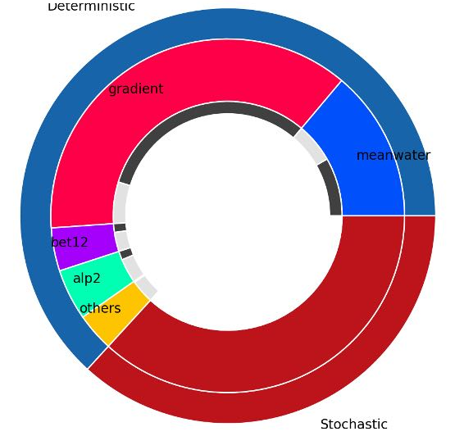
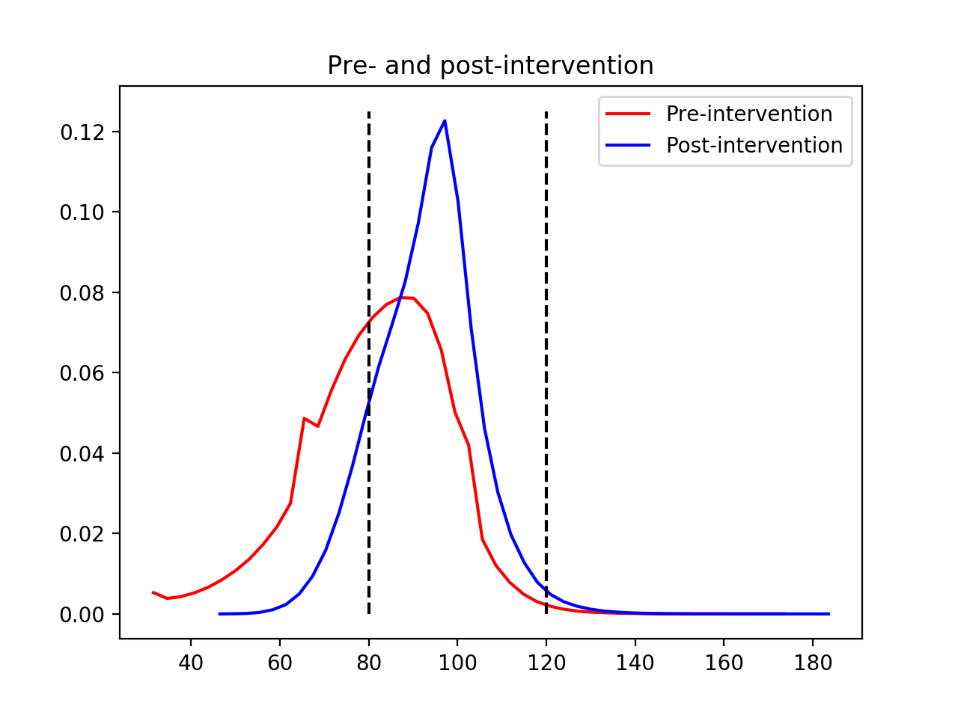

Disentangling drivers of emerging behavior from agent-based models
Alvaro Carmona Cabrero
Rafael Muñoz-Carpena
Woi Sok Oh
Rachata Muneepeerakul

Slide 56
Authors claiming for a BETTer understanding of ABM
“The more recent development of ‘bottom-up’ models, such as agent-based models (ABMs), now allows researchers to account for factors that affect human behavioural responses, although these are difficult to quantify at scale, such as individuals’ aversions to uncertainty or attachment to their birth location. Combining top-down and bottom-up modelling approaches may allow a more comprehensive means to examine the response of complex, emergent human dynamics[…]”
“GIVEN HOW MUCH is at stake in those [ABM] simulations, Barrett says, users always want to know why they should trust the results. How can they be sure that the model's output has anything to do with the real world—especially in cases such as nuclear disasters, which have no empirical data to go on?’
“The complexity of ABM has risen in stride with advances in computing power and resources, resulting in larger models with complex interactions and learning and whose outputs are often-high dimensional and require sophisticated analytical approaches.”
ABM […] comprehensive means to examine the response of complex, emergent human dynamics
GIVEN HOW MUCH is at stake in those [ABM] […] is output anything to do with the real world?
ABM […] outputs are often-high dimensional and require sophisticated analytical approaches
Wrathall, D.J., Mueller, V., Clark, P.U. et al. Meeting the looming policy challenge of sea-level change and human migration. Nature Clim. Chang. 9, 898–901 (2019) doi:10.1038/s41558-019-0640-4
Waldrop, M. M. (2018). Free agents, Science, 360(6385), 144-147.
https://doi.org/10.1126/science.360.6385.144
Lee, J. S., Filatova, T., Ligmann-Zielinska, A., Hassani-Mahmooei, B., Stonedahl, F., Lorscheid, I., et al. (2015). The complexities of agent-based modeling output analysis, Journal of Artificial Societies and Social Simulation, 18(4), 4. https://doi.org/10.18564/jasss.2897​

Slide 57
If migration is modeled as an ABM:
But what is the prediction limit of ABMs?
As the complexity of the model increases by including more components, the model behaves more as a black box
How can we understand ABMs with their “stochastic” interactions?
Five cities model
Simulation 1
Variability due to agent stochasticity with same inputs
Phase shift
Simulation 2
Short transient phase
Stationary phase

Slide 58
ABM - Global Sensitivity Analysis
Required formal study explained (input factors, “deterministic’) vs. unexplained (“stochastic”) components in ABM model predictions
Global Sensitivity Analysis (GSA):
  High-Dimensional Model Reduction technique (HDMR) for deterministic models (100% explained by changes in input factors)
  Can it be modified to decompose ABM explained vs. unexplained effects?
 | Local SA (classic) | Global SA
Model | Linear Monotonic additive | No assumptions
No. of factors | O-A-T | All together
Factor range | Local (derivative) | Whole PDF
Interactions | No | Yes

Slide 59
The method: Global Sensitivity Analysis
Sobol Variance Decomposition:
Deterministic models, $E\left[VM\left[Y | X\right]\right]$ = V_{err} $≈$ 0, M “plausible” multivariate combinations of input values
Stochastic ABM, V_{err} > 0, as same inputs may produce different output values
To assess stochastic variability, N repetitions of the model runs for each inputs set
M x N design allows to:
  N → separate output variance due to model’s stochasticity → unexplained variance V_{err}
  M→ separate output variance due to model’s input change →explained variance, V_{det}
For the explained variance:
  First (direct) effects: S_{i}=V_{i}/($V_{det}+V_{err}$)
  Total order effects: S_{Ti} ( i.e. for factor X₁)= S₁ + S₁₂ + S₁₃ + … + S₁₂₃ + …
  Interactions (higher order effects) : S_{Ti} – S_{i}
Explained variance
Unexplained variance
V(Y): variance of the output
V_{i}: variance due to input i
V_{err}: variance due to model stochasticity
R: residuals
$$V\left[Y\right]=V\left[EM\left[Y | X_{N}\right]\right]+E\left[VM\left[Y | X_{N}\right]\right]=V_{det}+V_{err}=\sum{(}Vi+Vij…+Verr)$$
How much N to pay?

Slide 60
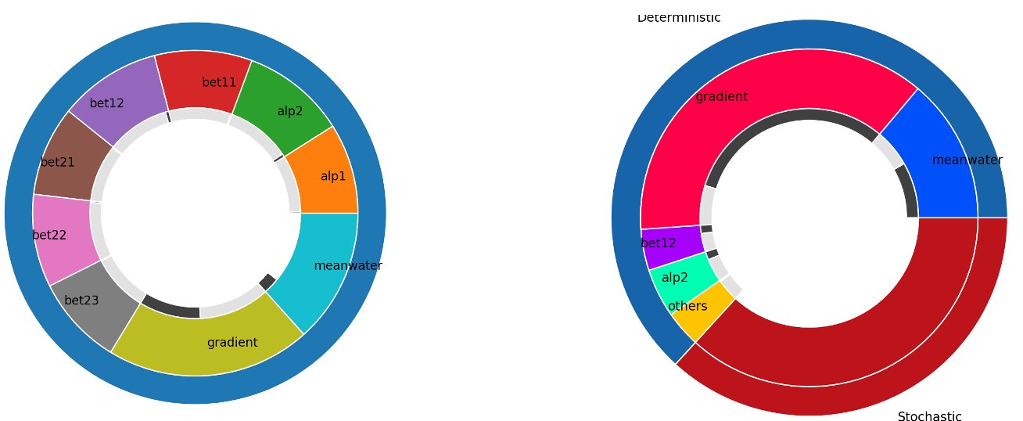
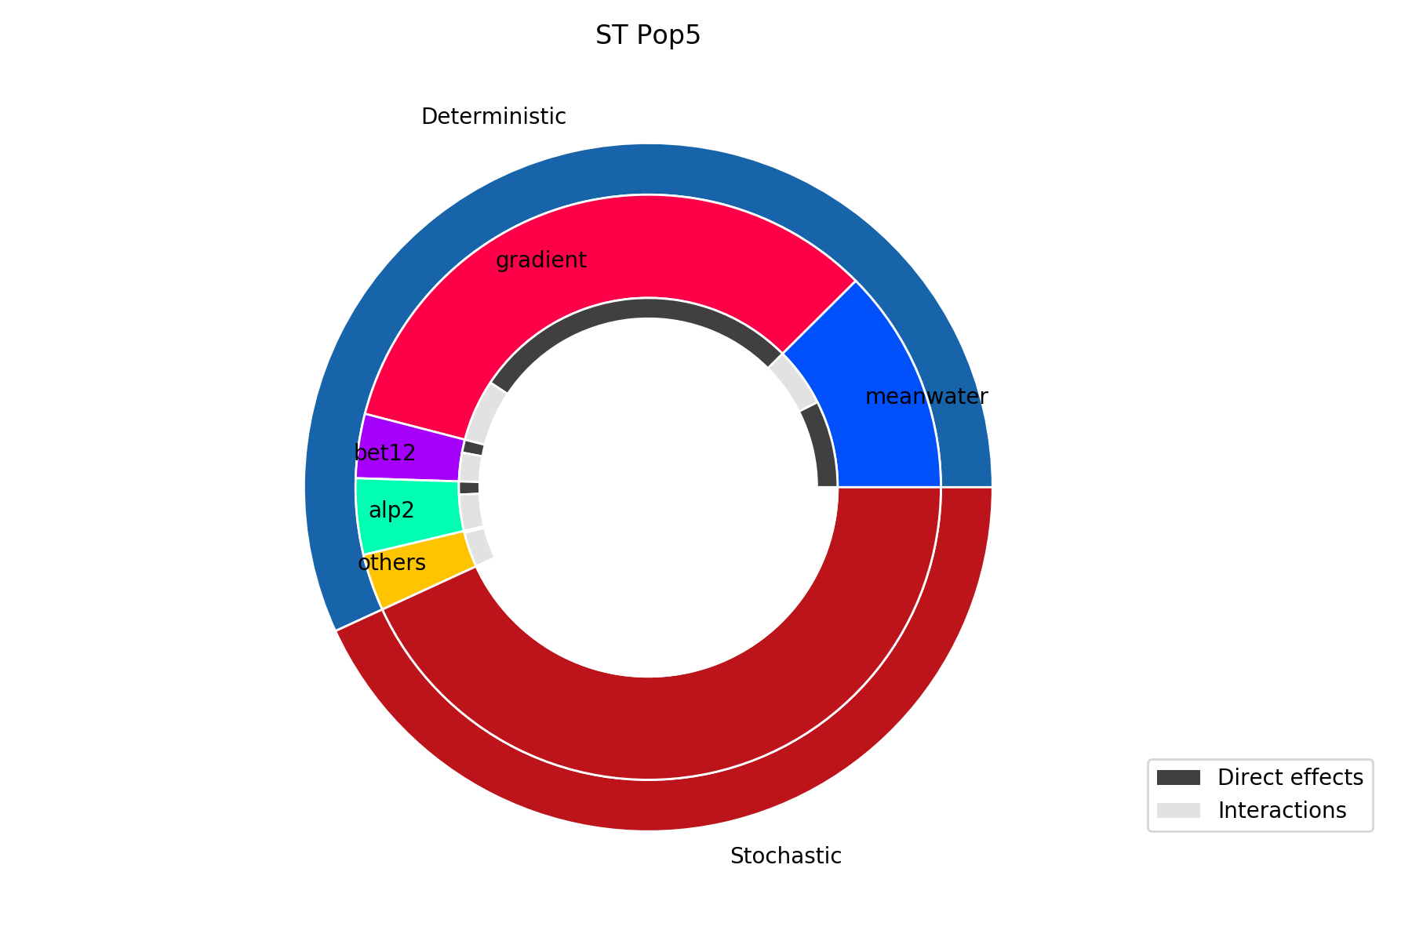
IDENTIFYING the stochastic VARIANCE
Quantifying V_{err} value drastically changes the understanding of the ABM predictions (ex. AND+AND MODEL):
Single ABM run (N=1)
N=125 repetitions
2
Most important input factor
See Poster
for more detail
% Un/Explained
(1st ring)
Explained 63%
Additive
Sensitivity indexes
(2nd ring)
Population 5
Population 5
Direct vs. Interactions (3rd ring)
Unexplained
37%
60

Slide 61
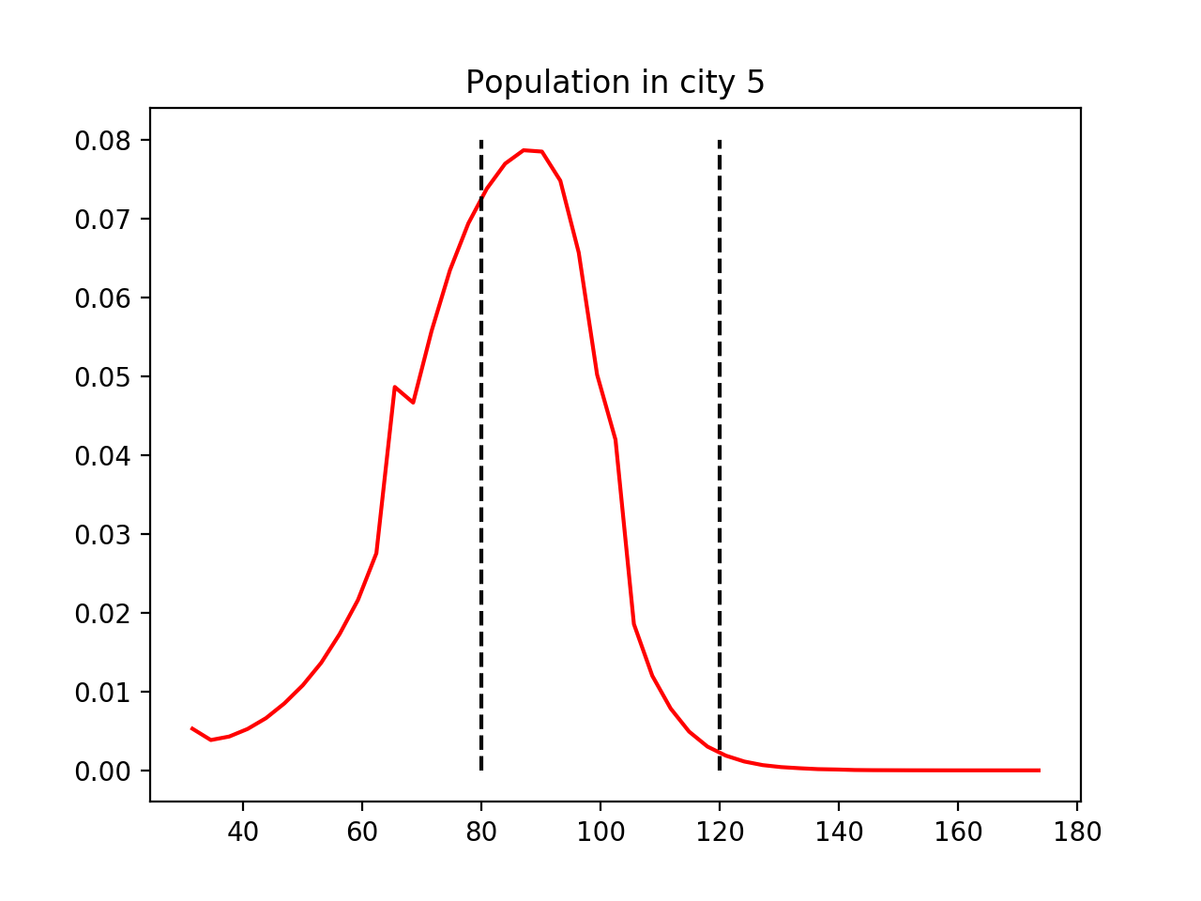
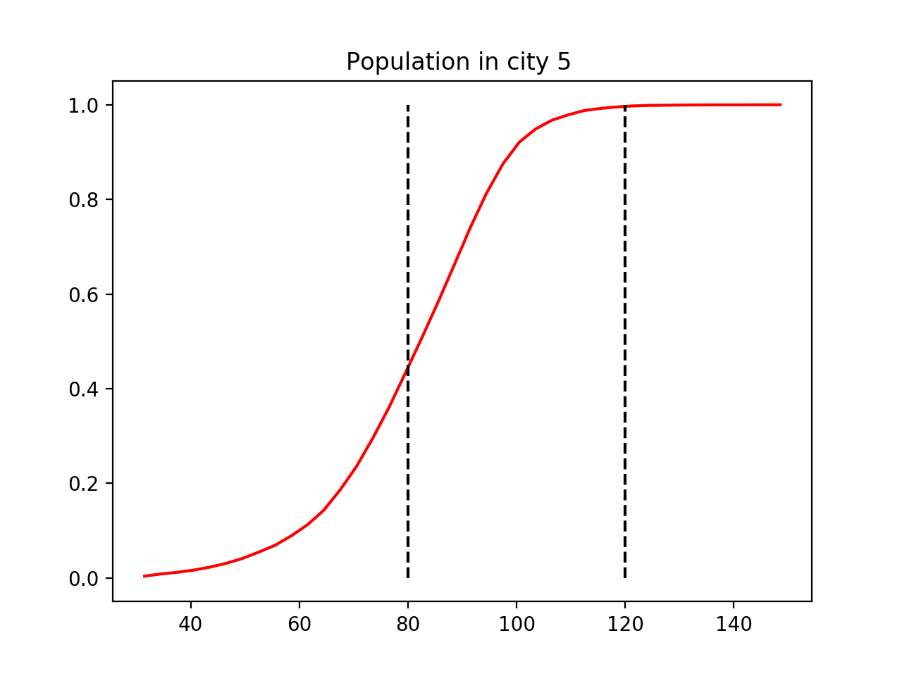
From ABM To Management: MCF
(Hornberger and Spear, 1989)
Definition of desirable migration scenarios:
  Behavioral: maintain Population 5 within ±20%, $B:$ 80 < Pop5 < 120
  Non-behavioral, $\overline{B}$
Pre-intervention, AND+AND
59%
$B:$ 59%
$\overline{B}:$41%

Slide 62
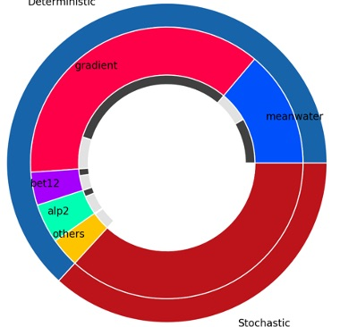
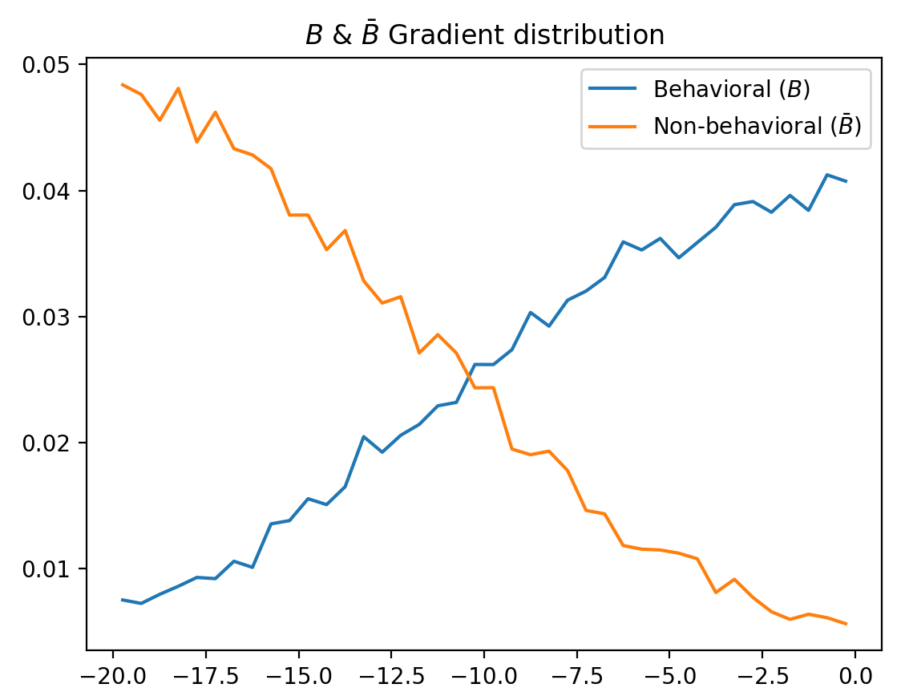
From ABM To Management: MCF
(Hornberger and Spear, 1989)
Monte Carlo Filtering (MCF) allows to find interventions/scenarios (range of important inputs) that would improve the probability of the desirable scenario B
Selection of important and “manageable” inputs:
  Gradient of water availability: 37% of total variance
    Pre-intervention:
      Gradient: U[-20, 0]
    Post-intervention (MCF)
      Gradient: U[-10.5, 0]
Population 5
Sensitivity Indexes

Slide 63
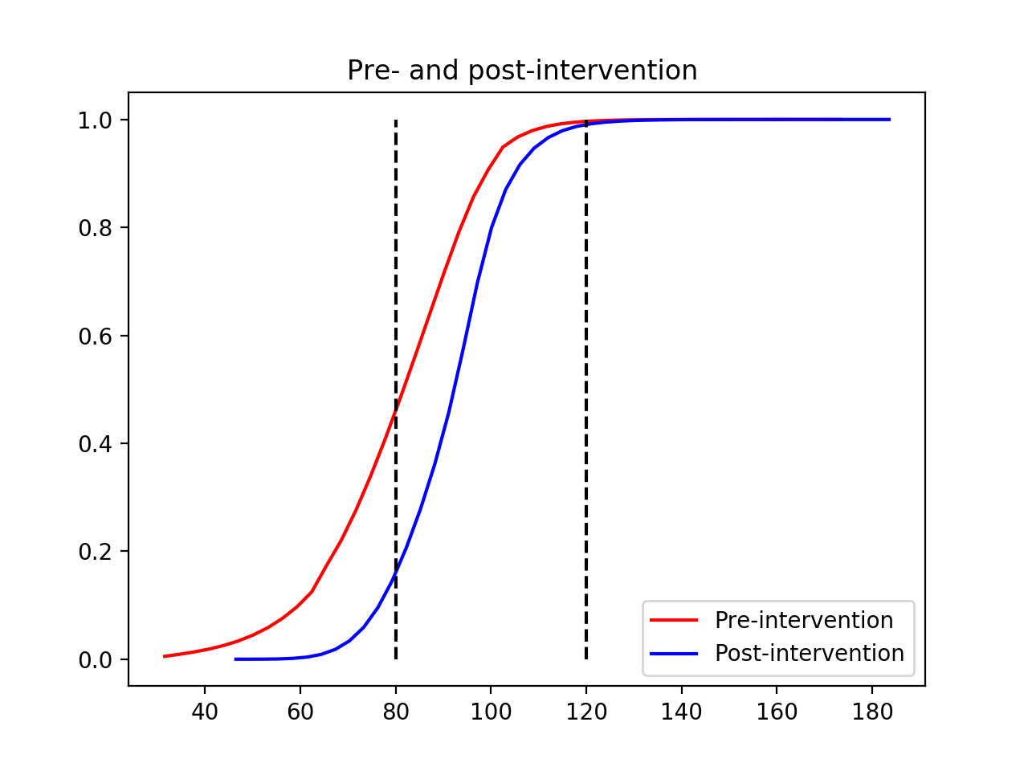
From ABM To Management: MCF
Population City 5, AND+AND
59%
86%
Efficiency of intervention:$B:$ 59% to $B:$86%

Slide 64
Conclusions
2
See Poster
for more detail
We address current critique of ABMs: its stochastic behavior
Critical understanding of ABM’s outcomes: deterministic vs stochastic components
Implications for predictions and management interventions
Future quantification of effects of increasing model complexity in Migration Models
Future screening/diagnosis of costly models (N needed)

Slide 65
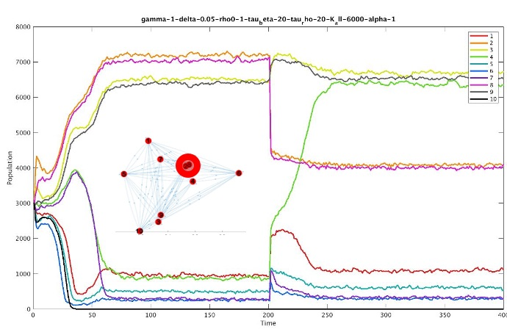

MINIMALISTIC, MECHANISTIC MODEL OF MIGRATION & EFFECTS OF TRANSIENT DRIVERS
Gonzalo Pablo Suarez
Rachata Muneepeerakul

Slide 66
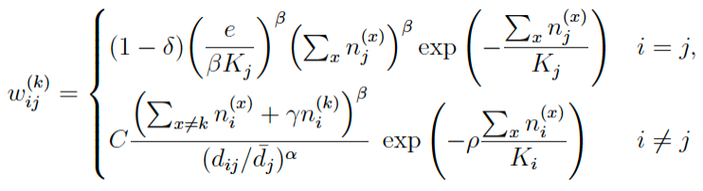

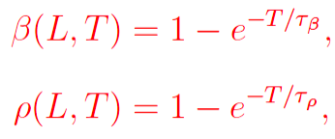
Only the environment, social tie, and distance are included for now
4
See Poster
for more detail
K: capacity indicator—how much population the environment can support—a place holder to connect with other models, e.g., food security
β: scaling law between population size and economic opportunities
Total population
α: effect of the distance
γ: weight for social tie
“First flee, worry about jobs and the environment later!”

Slide 67
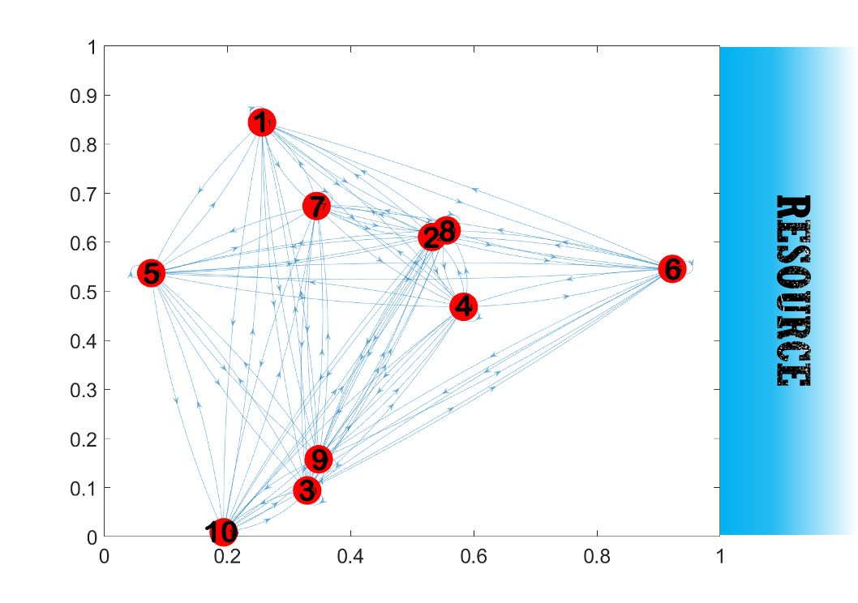
System setup
Consider a system of 10 cities, randomly placed
Distance from the resource determine the resource availability and capacity of these cities to support population
Populations make migration decisions according to the equation in the previous slide

Slide 68
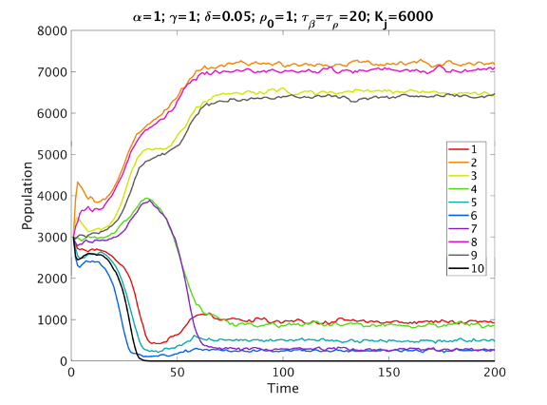
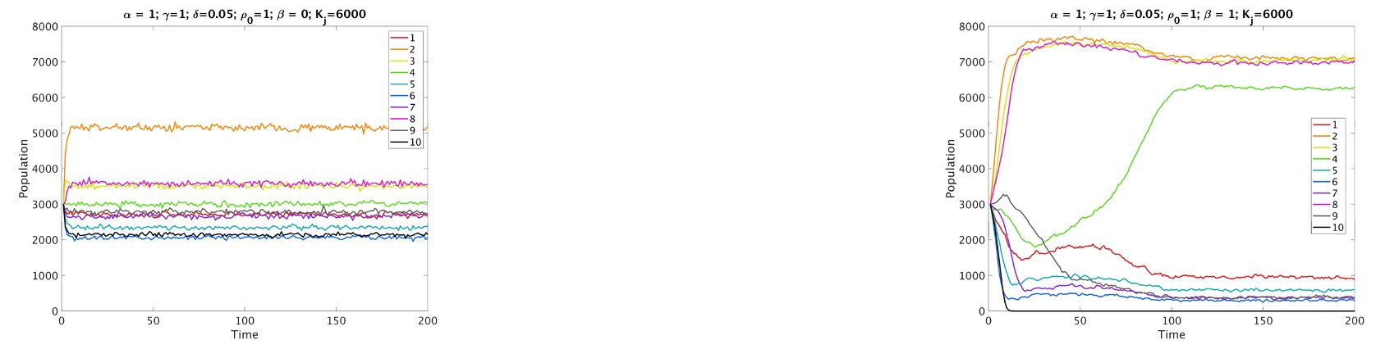
Effects on transient behavior of migration
No consideration for economic opportunities or environmental conditions. Diffusion-like.
“First flee, worry about jobs and the environment later”
Some legacy effects observed: different initial transient dynamics lead to different long-term outcomes.
Take into account economic opportunities and environmental conditions for the very start, all the way through.

Slide 69
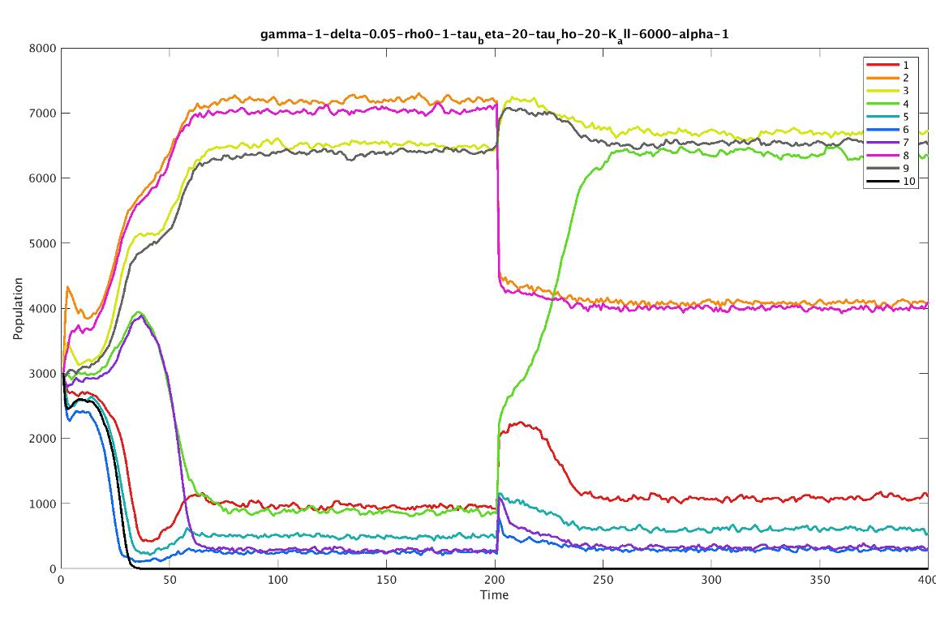
Migration under sudden shocks vs. graduate changes
4
See Poster
for more detail
Given the legacy effects, sudden shocks vs. gradual changes could lead to different long-term outcomes.
Migration response to sudden shocks and gradual changes under a coherent modeling framework.
Capacities of cities 2 and 8 suddenly reduced.
Large-scale stressors, e.g., food security, will be coupled with the model through K

Slide 70
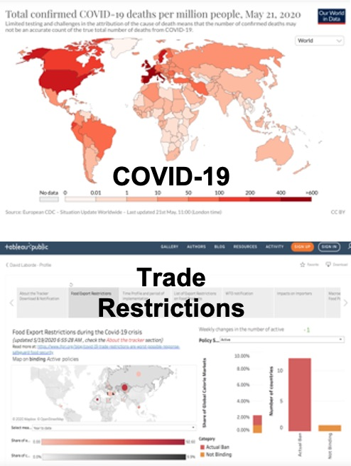
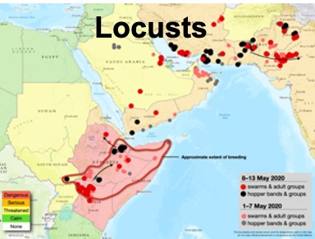
Large-scale stressors and migration: a COVID-19 case study on food security
Theresa Falkendal, Christian Otto, Jacob Schewe, Potsdam Institute for Climate Research
Michael Puma, Jonas Jägermeyr, Columbia University
Megan Konar, University of Illinois Urbana Champaign
Ben Watkins, Kimetrica

Slide 71
COVID-19 & Food Security – a key stressor
“Risk of hunger pandemic as COVID-19 set to almost double acute hunger by end of 2020”
“These new numbers show the scale of the catastrophe we are facing.”
“People are losing their livelihoods and their incomes, and supply chains are disrupted. This translates into a double whammy”
“Latest numbers indicate the lives and livelihoods of 265 million people in low and middle-income countries will be under severe threat unless swift action is taken to tackle the pandemic, up from a current 135 million.
Food security will be included in our minimalistic model through K, the environmental carrying capacity
Source: https://insight.wfp.org/covid-19-will-almost-double-people-in-acute-hunger-by-end-of-2020-59df0c4a8072

Slide 72
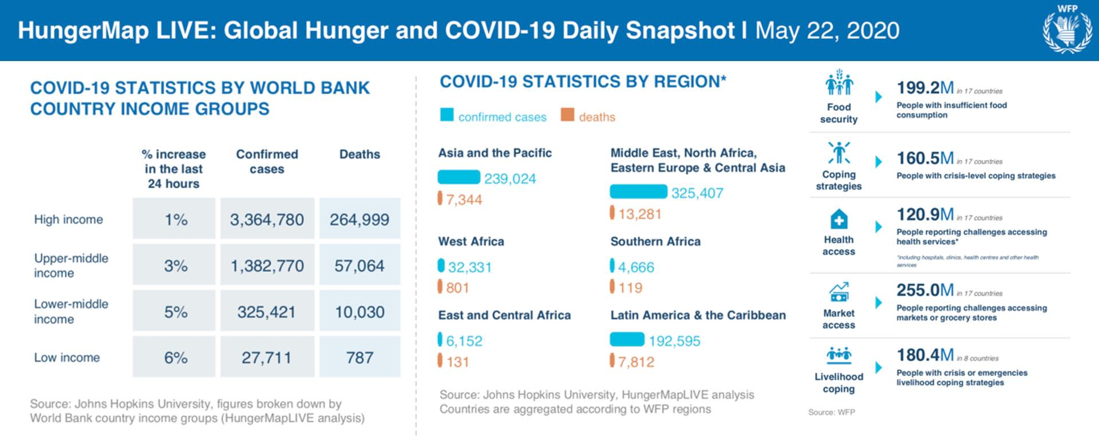
Current situation
Source: https://api.hungermapdata.org/covid/dailyreport, 5/22/2020.

Slide 73
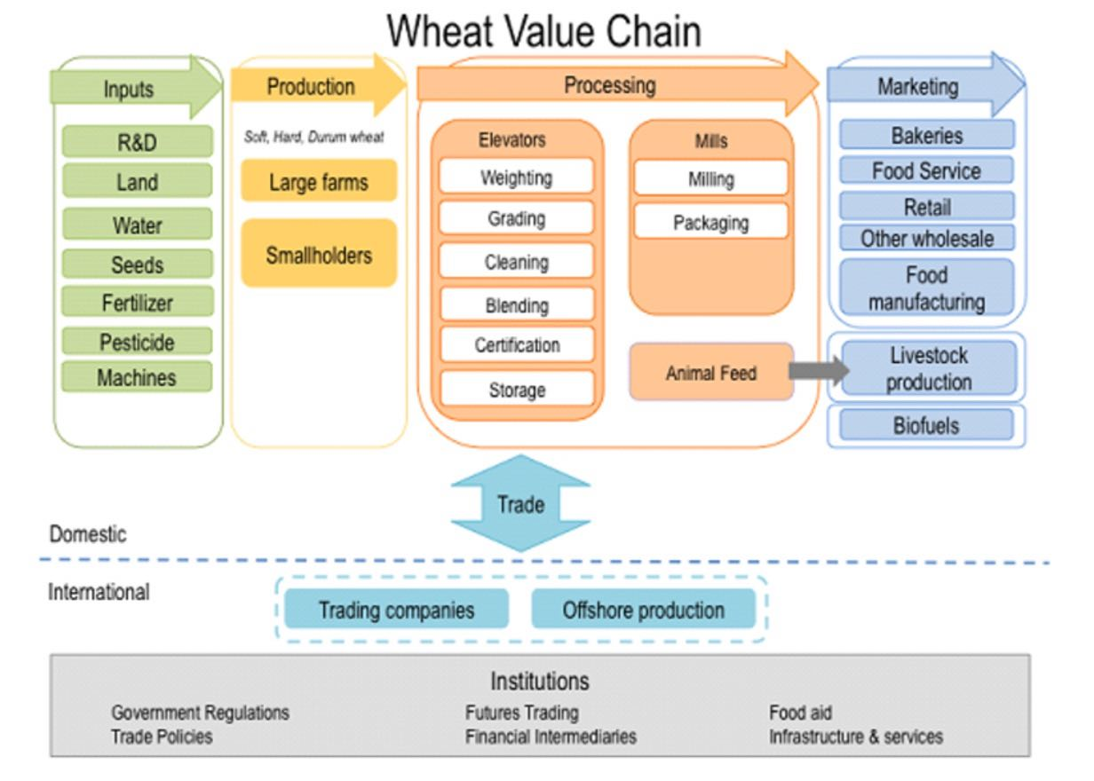
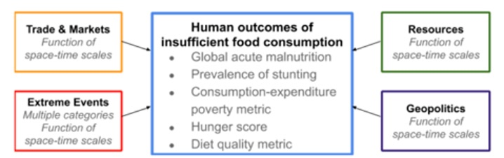
Risk in food Value chains
What scenarios threaten food value chains at different levels?
Identify indicators to link with migration models
Source: Duke Minerva, https://sites.duke.edu/minerva/files/2013/08/wvc.png, Accessed 5/22/2020.

Slide 74

MULTI-SCALE APPROACHES
International level
Domestic level

Slide 75
MULTI-SCALE APPROACHES
International level
Domestic level

Slide 76

food production Pressures – Global Picture
2020 is a year where food production and distribution are under tremendous pressure due to COVID-19, locusts, and dryer-then-normal weather.
Source:
https://cropmonitor.org/, accessed 5/22/2020

Slide 77

food production Pressures – Local Concerns
Desert Locust Situation Update for May 13, 2020
Source:
http://www.fao.org/ag/locusts/common/ecg/75/en/200513update.jpg

Slide 78

Grain reserves are Relatively high
… plus oil prices are low
Source: IFRI, https://www.ifpri.org/blog/covid-19-trade-restrictions-are-worst-possible-response-safeguard-food-security, accessed 5/22/2020

Slide 79

Trade restriction risk
Source: https://public.tableau.com/profile/laborde6680#!/vizhome/ExportRestrictionsTracker/FoodExportRestrictionsTracker, accessed 5/22/2020

Slide 80


Scenario Tools & analysis
We use the Trade WIth Storage (TWIST) to:
Quantitatively model world market prices and storage movements in world regions
Accounts for trade policies, commercial and public inventory holding
Food Shock Cascade model computes chain-reactions due to production anomalies (e.g. our US Dust Bowl paper) BUT here we simplify – for harmonization purposes – looking only at a supply balance for scenarios:
Domestic Supply = Domestic Production + Imports – Exports + Reserve Use

Slide 81
Defining COVID-19 food scenarios
Country | Wheat Production Decline
Kenya | 0.49
Saudi Arabia | 0.45
Yemen | 0.23
Ukraine | 0.21
Kazakhstan | 0.18
Iran | 0.10
Ethiopia | 0.09
Russia | 0.08
Country | Rice Production Decline
Kenya | 0.34
Pakistan | 0.20
Iran | 0.19
Thailand | 0.021
India | 0.019
Vietnam | 0.0012
Country | Maize Production Decline
Saudi Arabia | 0.53
Somalia | 0.48
Iran | 0.30
Yemen | 0.25
Kenya | 0.15
Brazil | 0.13
Ethiopia | 0.13
Argentina | 0.12
Ukraine | 0.088
Pakistan | 0.07
Bold text => major exporting country
=> 20 percentile historical production decline
Regular text => country impacted by locusts
=> 5 percentile historical production decline

Slide 82




Wheat Scenario
Global price changes from the TWIST model

Slide 83


Maize Scenario
Global price changes from the TWIST model

Slide 84


Rice Scenario
Global price changes from the TWIST model

Slide 85
SOME TAKE-AWAYS
Trade disruptions impact price more than production shortfalls. Export restrictions can easily limit the amount of food available to a larger degree then historically severe world production declines.
The combined effect of export restrictions together with increase in demand and/or local production declines is most devastating in terms of creating world market price spikes.
Some middle-income countries play a more important role than one might expect, especially policy makers that are not involved in food/agriculture. Unilateral actions by these countries can decide whether the world market remains stable during the COVID-19 pandemic or if "market panic" arises.

Slide 86
MULTI-SCALE APPROACHES
International level
Domestic level

Slide 87

A NEW ANALYSIS IN PROGRESS
Source: https://graphics.reuters.com/HEALTH-CORONAVIRUS/USA-MEATPACKING/qmypmnxxbvr/index.html, accessed 5/22/2020.

Slide 88


COVID-19 Supply chain disruption
Source: https://graphics.reuters.com/HEALTH-CORONAVIRUS/USA-MEATPACKING/qmypmnxxbvr/index.html, accessed 5/22/2020.

Slide 89


Building a County-to-County Cascade model
Food Shock Cascade model
US county level flows (Fig 5, Lin et al., 2019)
+
Understand cascading threats to meat (i.e. protein) supply chains in US
University of Illinois at Urbana-Champaign
Prof. Megan Konar
Students:
Paul Ruess, Akshay Pandit, Deniz Karakoc
See: http://mkonar.cee.illinois.edu/people.html

Slide 90










Dissemination of project’s findings
G5
Disseminate

Slide 91




Pieces of the puzzle have been systematically tackled and connected. Further integration is next.
Migration scenarios
Case studies
GSUA
Next up:
Lunch + poster viewing in TEAMS channels
Reconvene at 12pm
Migration theories
Data
GSUA
NLTS
Stylized facts
BI
Predictive model
Integrative
Theory
Brainstorming
GSUA
MRQAP
CCM
PMI
BI
[Parameters]
Dynamical system
Agent-based
Climate/
hydrological/
environmental
Concept map
GSUA: global sensitivity/ uncertainty analysis
MRQAP: multiple regression quadratic assignment procedure
CCM: convergent cross mapping
PMI: partial mutual information
BI: Bayesian inference
NLTS: nonlinear timeseries analysis
Causal
networks, relationships, & patterns

